Slide 1
CURIE H.S.
ART & ACTIVISM
ARTivism, &
ARTivism II (H)/III(H)
art courses
Instructor: Valerie Xanos, Curie HS
4959 S. Archer Ave.
Chicago, IL 60632

Slide 2
ARTivism
ARTivism - Introductory beginners level. Any Curie student can take this course.
ARTivism II - Honors level. Course Teacher approval required. (can earn service hours)
ARTivism III - Honors level, Independent study option. Course Teacher approval required. (can earn service hours)
A new track of art courses exploring art and social activism.

Slide 3
Current Course Name SY22 | New Course Name SY23 | Brief Course Description | Requires Approval from Teacher
Topics in World Art | ARTivism | 9-12, Introductory level course - Creating art about social justice. | No, anyone interested can take the course. Prefer students with an interest in social justice/civics. Can feed into ARTivism II-H.
ARTivism | ARTivism II-H | 11-12 Advanced, Honors level. Creating art about social justice. As part of the Guerrilla Art Collective, students help create the curriculum. Part of the SPACE program. (art and civics program with the MCA) | Yes, students must meet with Ms. Xanos with a portfolio for entrance interviews. Taking Intro ARTivism helps prepare students.
MultiMedia II | ARTivism III-H | Grade 12 Advanced, Honors level. Option of Independent Study project. Creating art about social justice. As part of the Guerrilla Art Collective, students help create the curriculum. Part of the SPACE program. (art and civics program with the MCA) | Yes, students must meet with Ms. Xanos with a portfolio for the entrance interview. Must have passed ARTivism II.

Slide 4
ARTivism
Instructor: V. Xanos
Change the world! This exciting introductory course teaches you how to create art that addresses social issues. Learn about different kinds of contemporary art materials and processes like drawing, painting, sculpture, printmaking, photography, performance, etc. We learn from artists such as Banksy, Maria Gaspar, & Shepard Fairey to create projects like sticker art, wheat pastes, and other fun ideas. We are partnered with the Museum of Contemporary Art for special field trips. This course prepares you for the ARTivism II class, which can be taken for honors
.
Sign up for ARTivism during programming.
Previously called Topics in World Art
(9-12 enrollment)

Slide 5
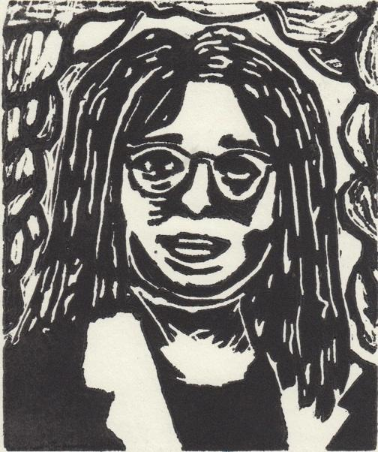
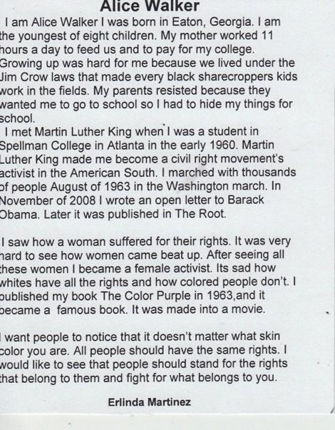
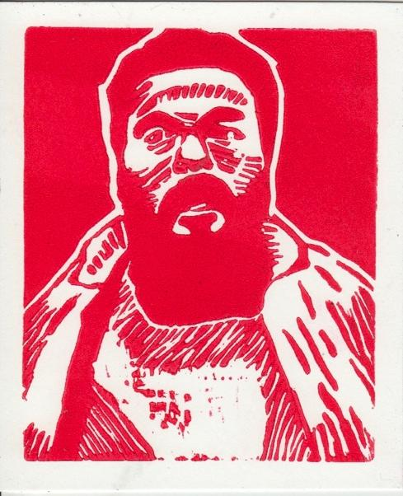
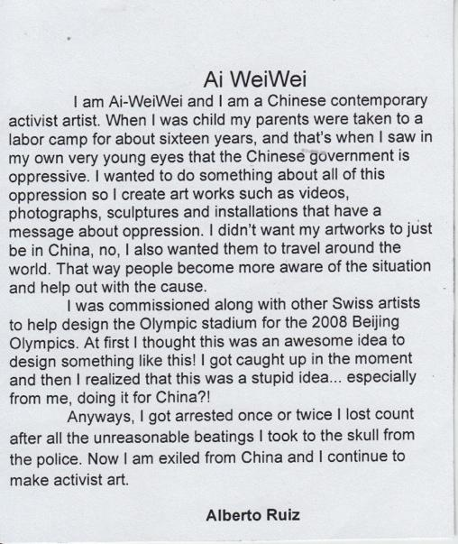
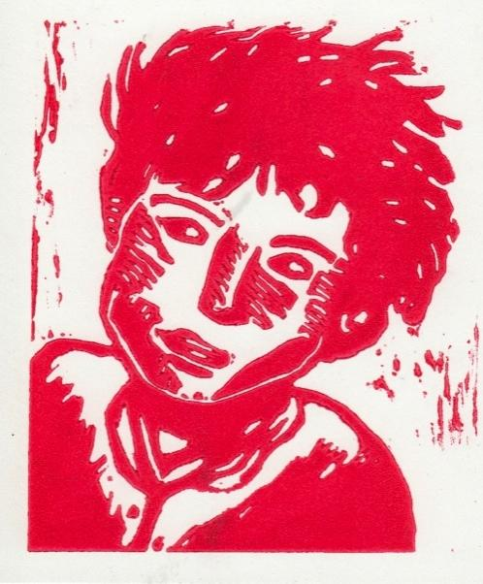
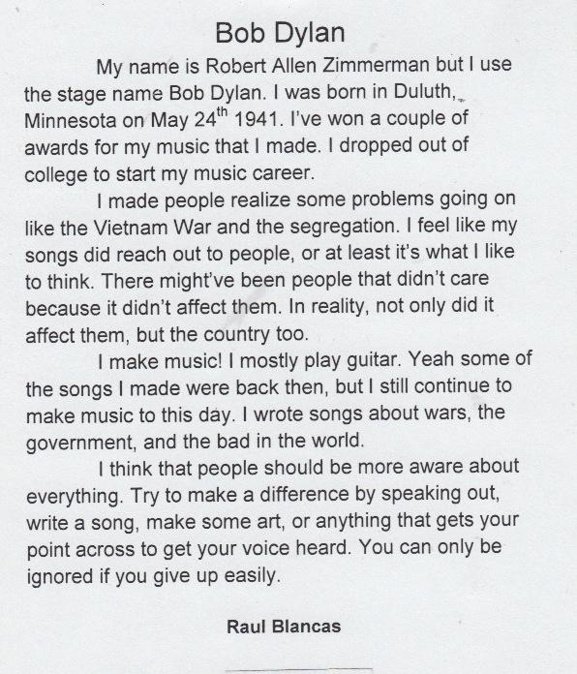
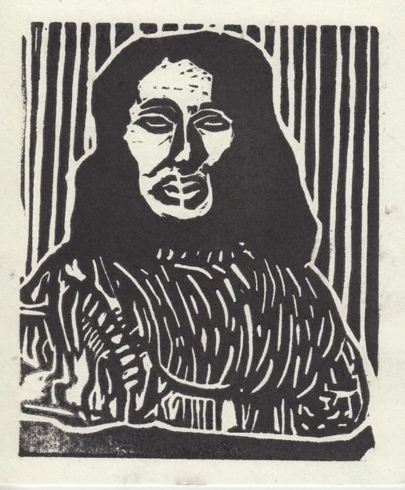
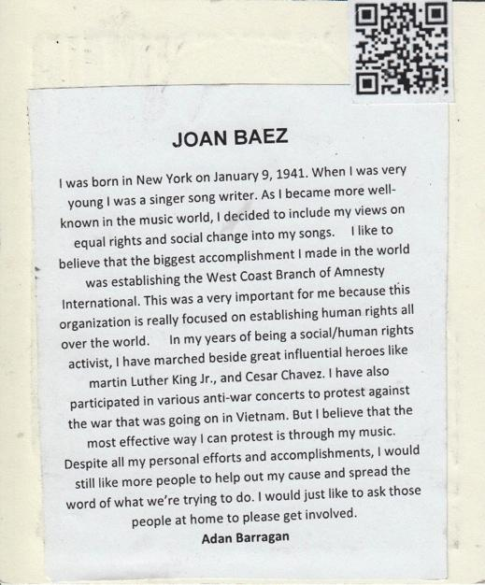
ARTivism: Hero Trading Cards

Slide 6
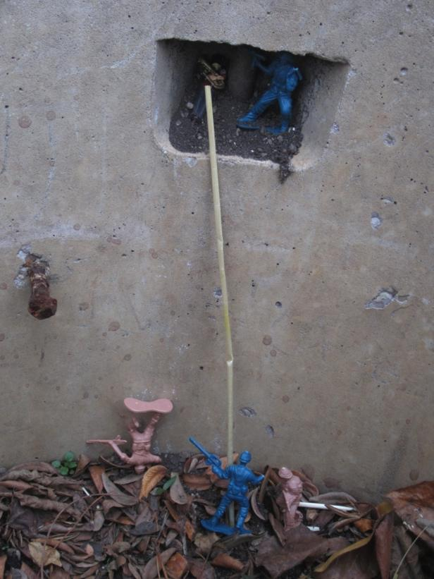
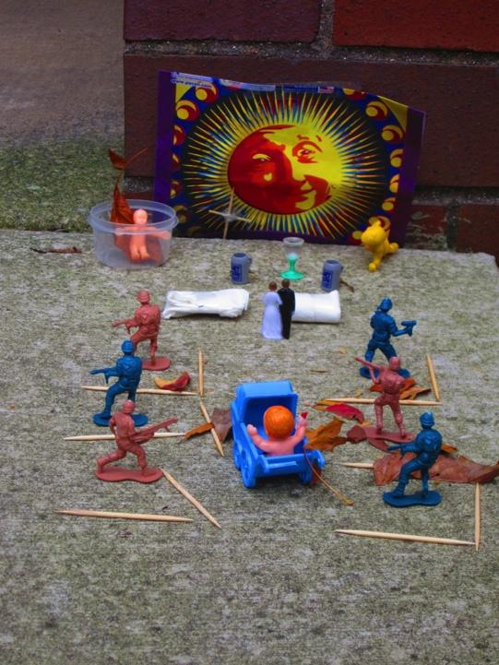
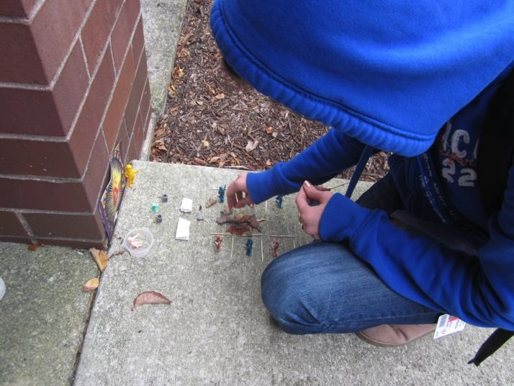
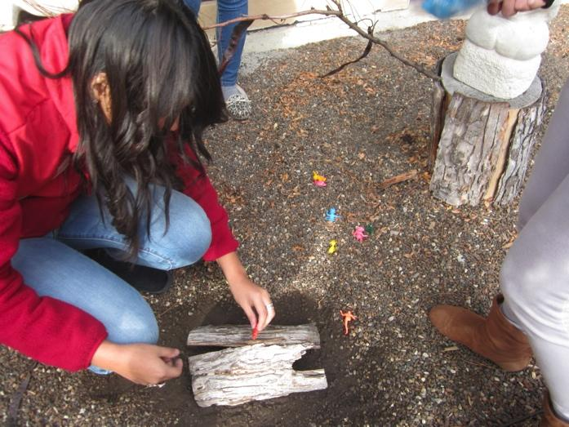
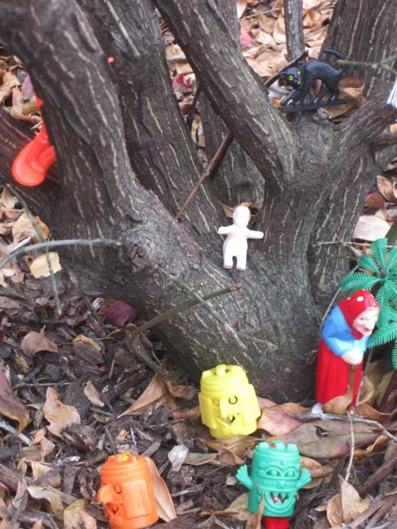
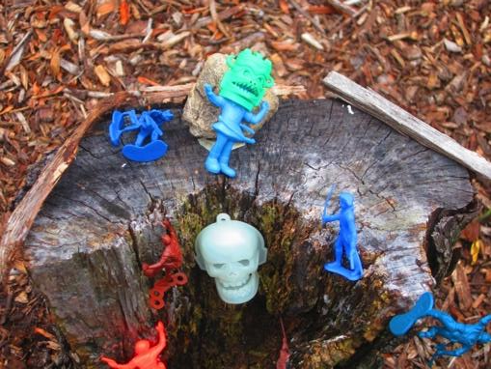
ARTivism: Micro-World Installations

Slide 7
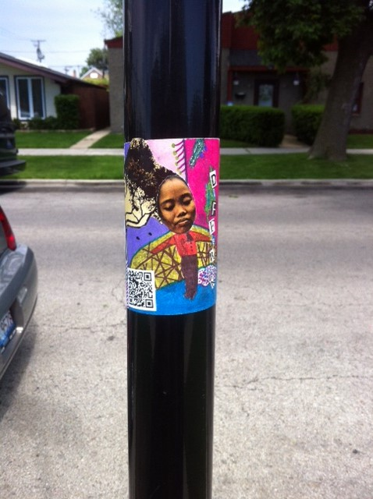
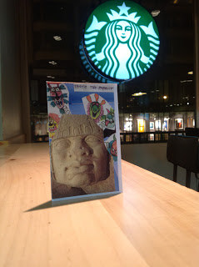
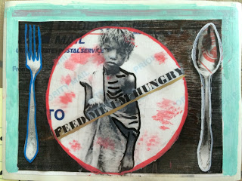
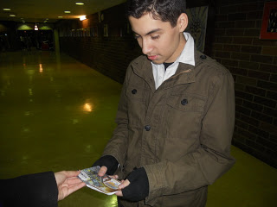
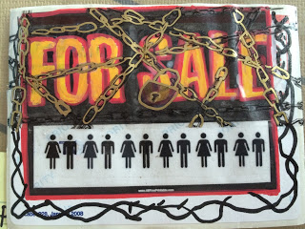
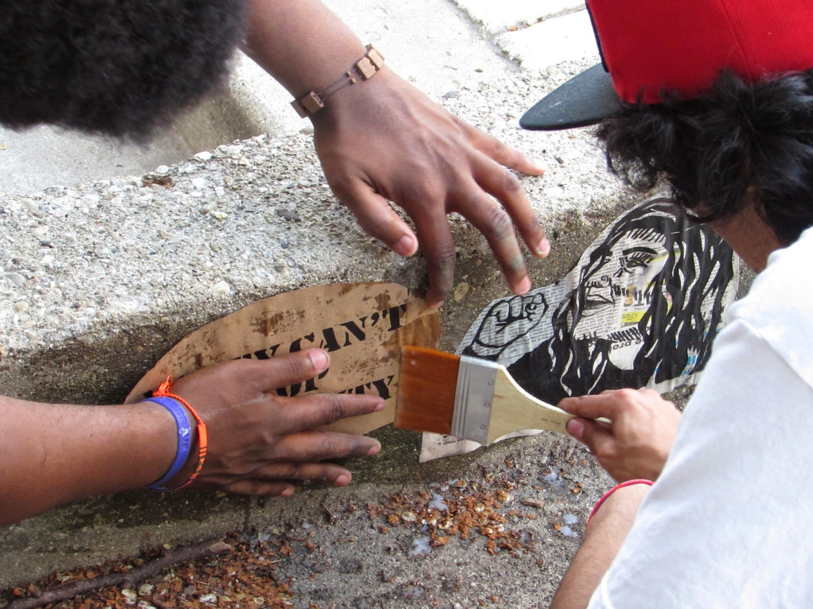
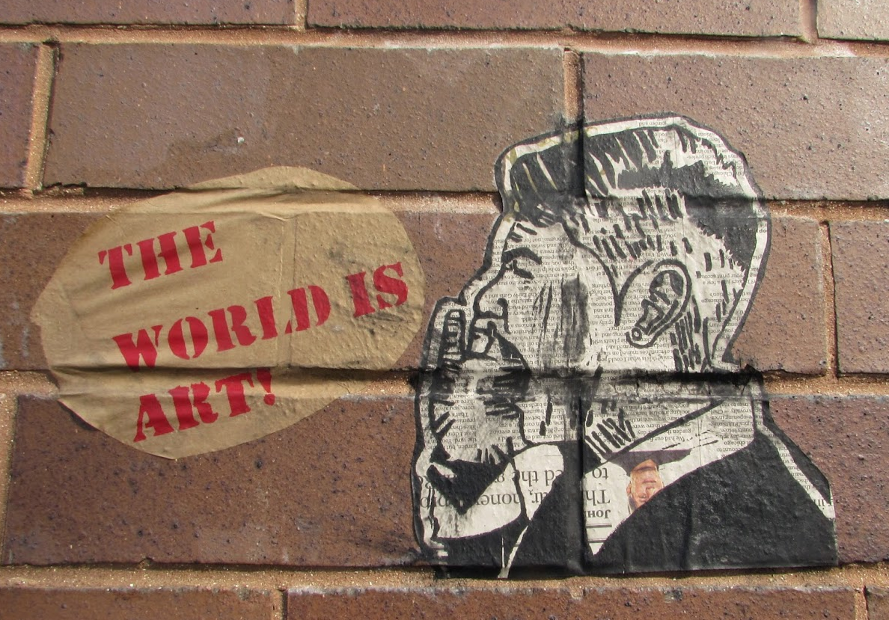
ARTivism:
Art in the Community: Stickers, ‘Zines, Wheat Pastes

Slide 8
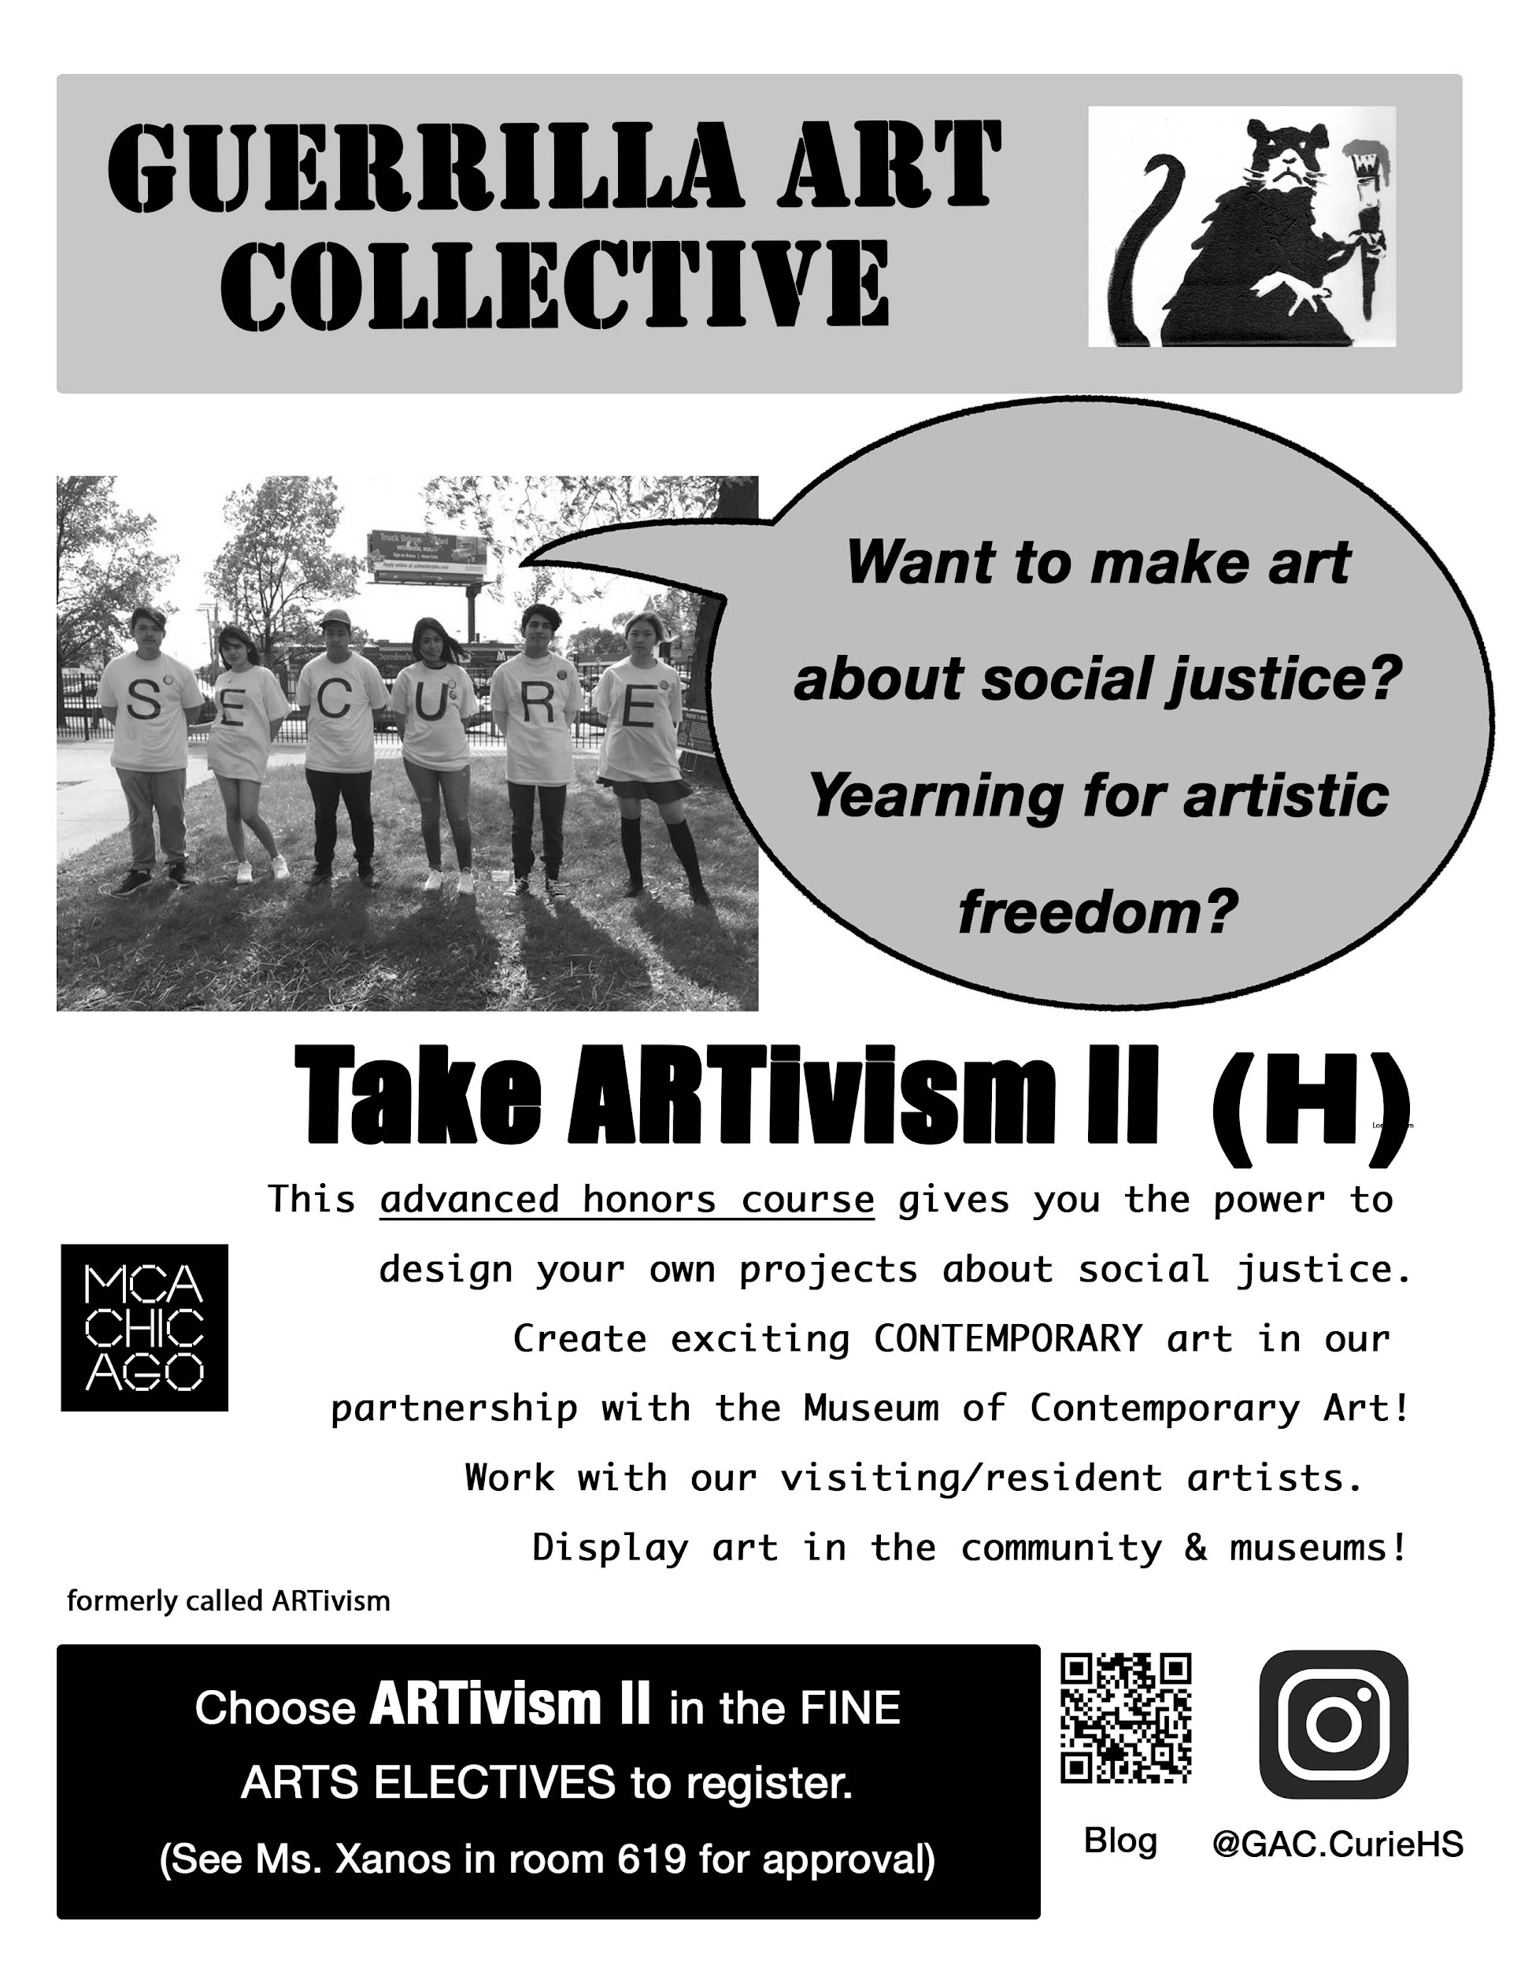

Slide 9
ARTivism II (H) & III (H)
Instructor: V. Xanos
Change the world!
These exciting advanced honors classes combine social activism and art.
In these courses, students continue on the path of ARTivism to a higher level of honors to explore how artists and activists have responded to the call for social justice and change, whether through political or activist art, and the ways in which artists and art collectives “socially enact” their perspectives across various historical and social circumstances. Students will research current topics of urban life, personal experiences, and social activism; then respond by creating collaborative art as a collective of artists. ARTivism III students will have the option for an independent study project.
Skills around the artistic process of collaboration and collectivity will allow students to realize their own projects as student-based creations rather than teacher-based assignments. Students should be independent workers as they will help design the projects. Student projects will be focused on civically-minded community engagement and creating change in the world through artistic agency. Students will learn from the teacher and contemporary artist partners (such as resident or visiting artists) to develop their collective artistic practice, starting as smaller projects and culminating in a large project at the end of the year. We are connected with the MCA SPACE program and benefit from special resources. This project may be used for earning service learning hours.
Check out our work via Instagram @GAC.CurieHS or www.GuerrillaArt4.blogspot.com
Sign up for ARTivism II or III during programming. Teacher approval required. See Ms. Xanos in room 619 (Junior and Senior enrollment only)
Previously called ARTivism and MultiMedia

Slide 10

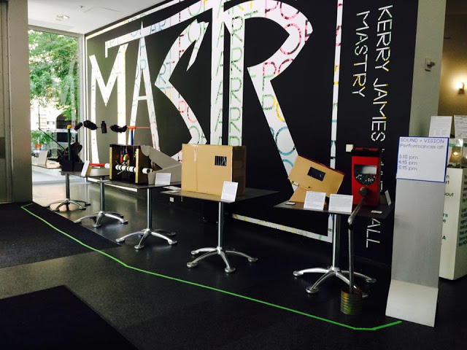
ARTivism II: Guerrilla Art Collective
Sound Sculptures on display at the Museum of Contemporary Art, 21 Minus Fest, 2016
Film screened at the MCA, 21 Minus Fest, 2015
Click to play the film

Slide 11

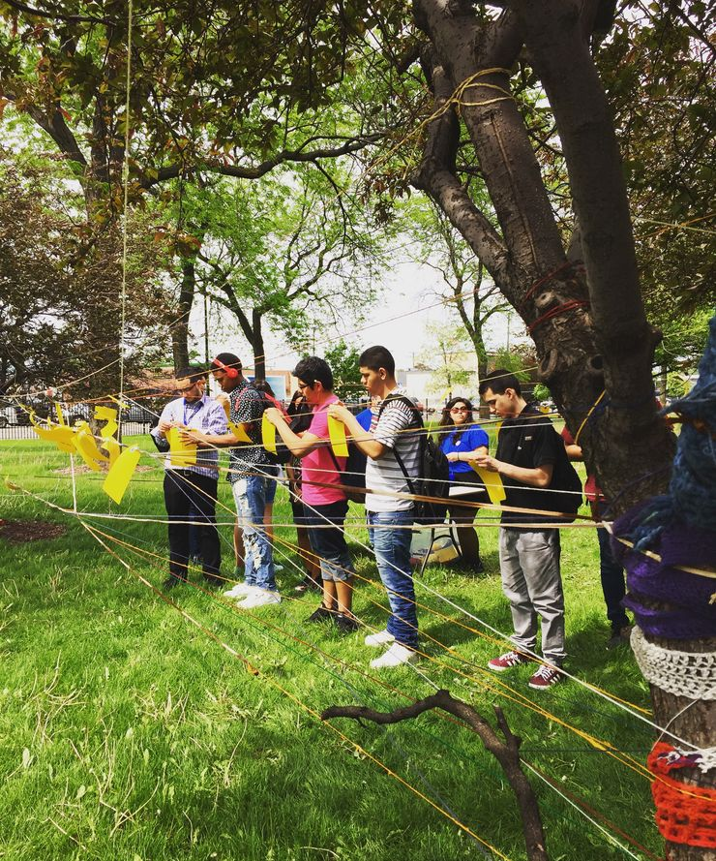
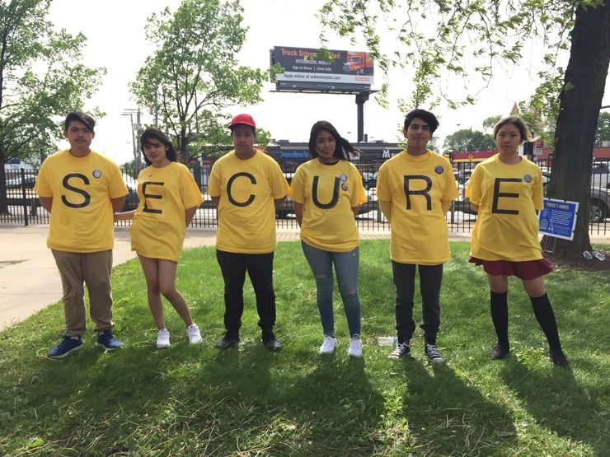
ARTivism II: Guerrilla Art Collective
Sanctuary Festival at Curie High School and the Museum of Contemporary Art’s 21 Minus Fest, 2017.

Slide 12
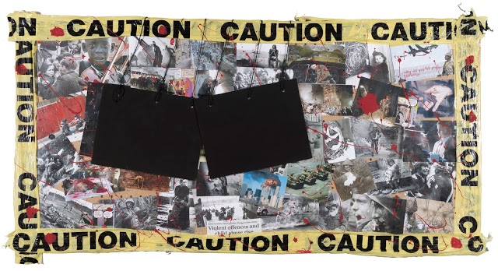
ARTivism II/III: Guerrilla Art Collective
Artwork from published book “Identity Crisis”, 2018.
click here to view book

Slide 13
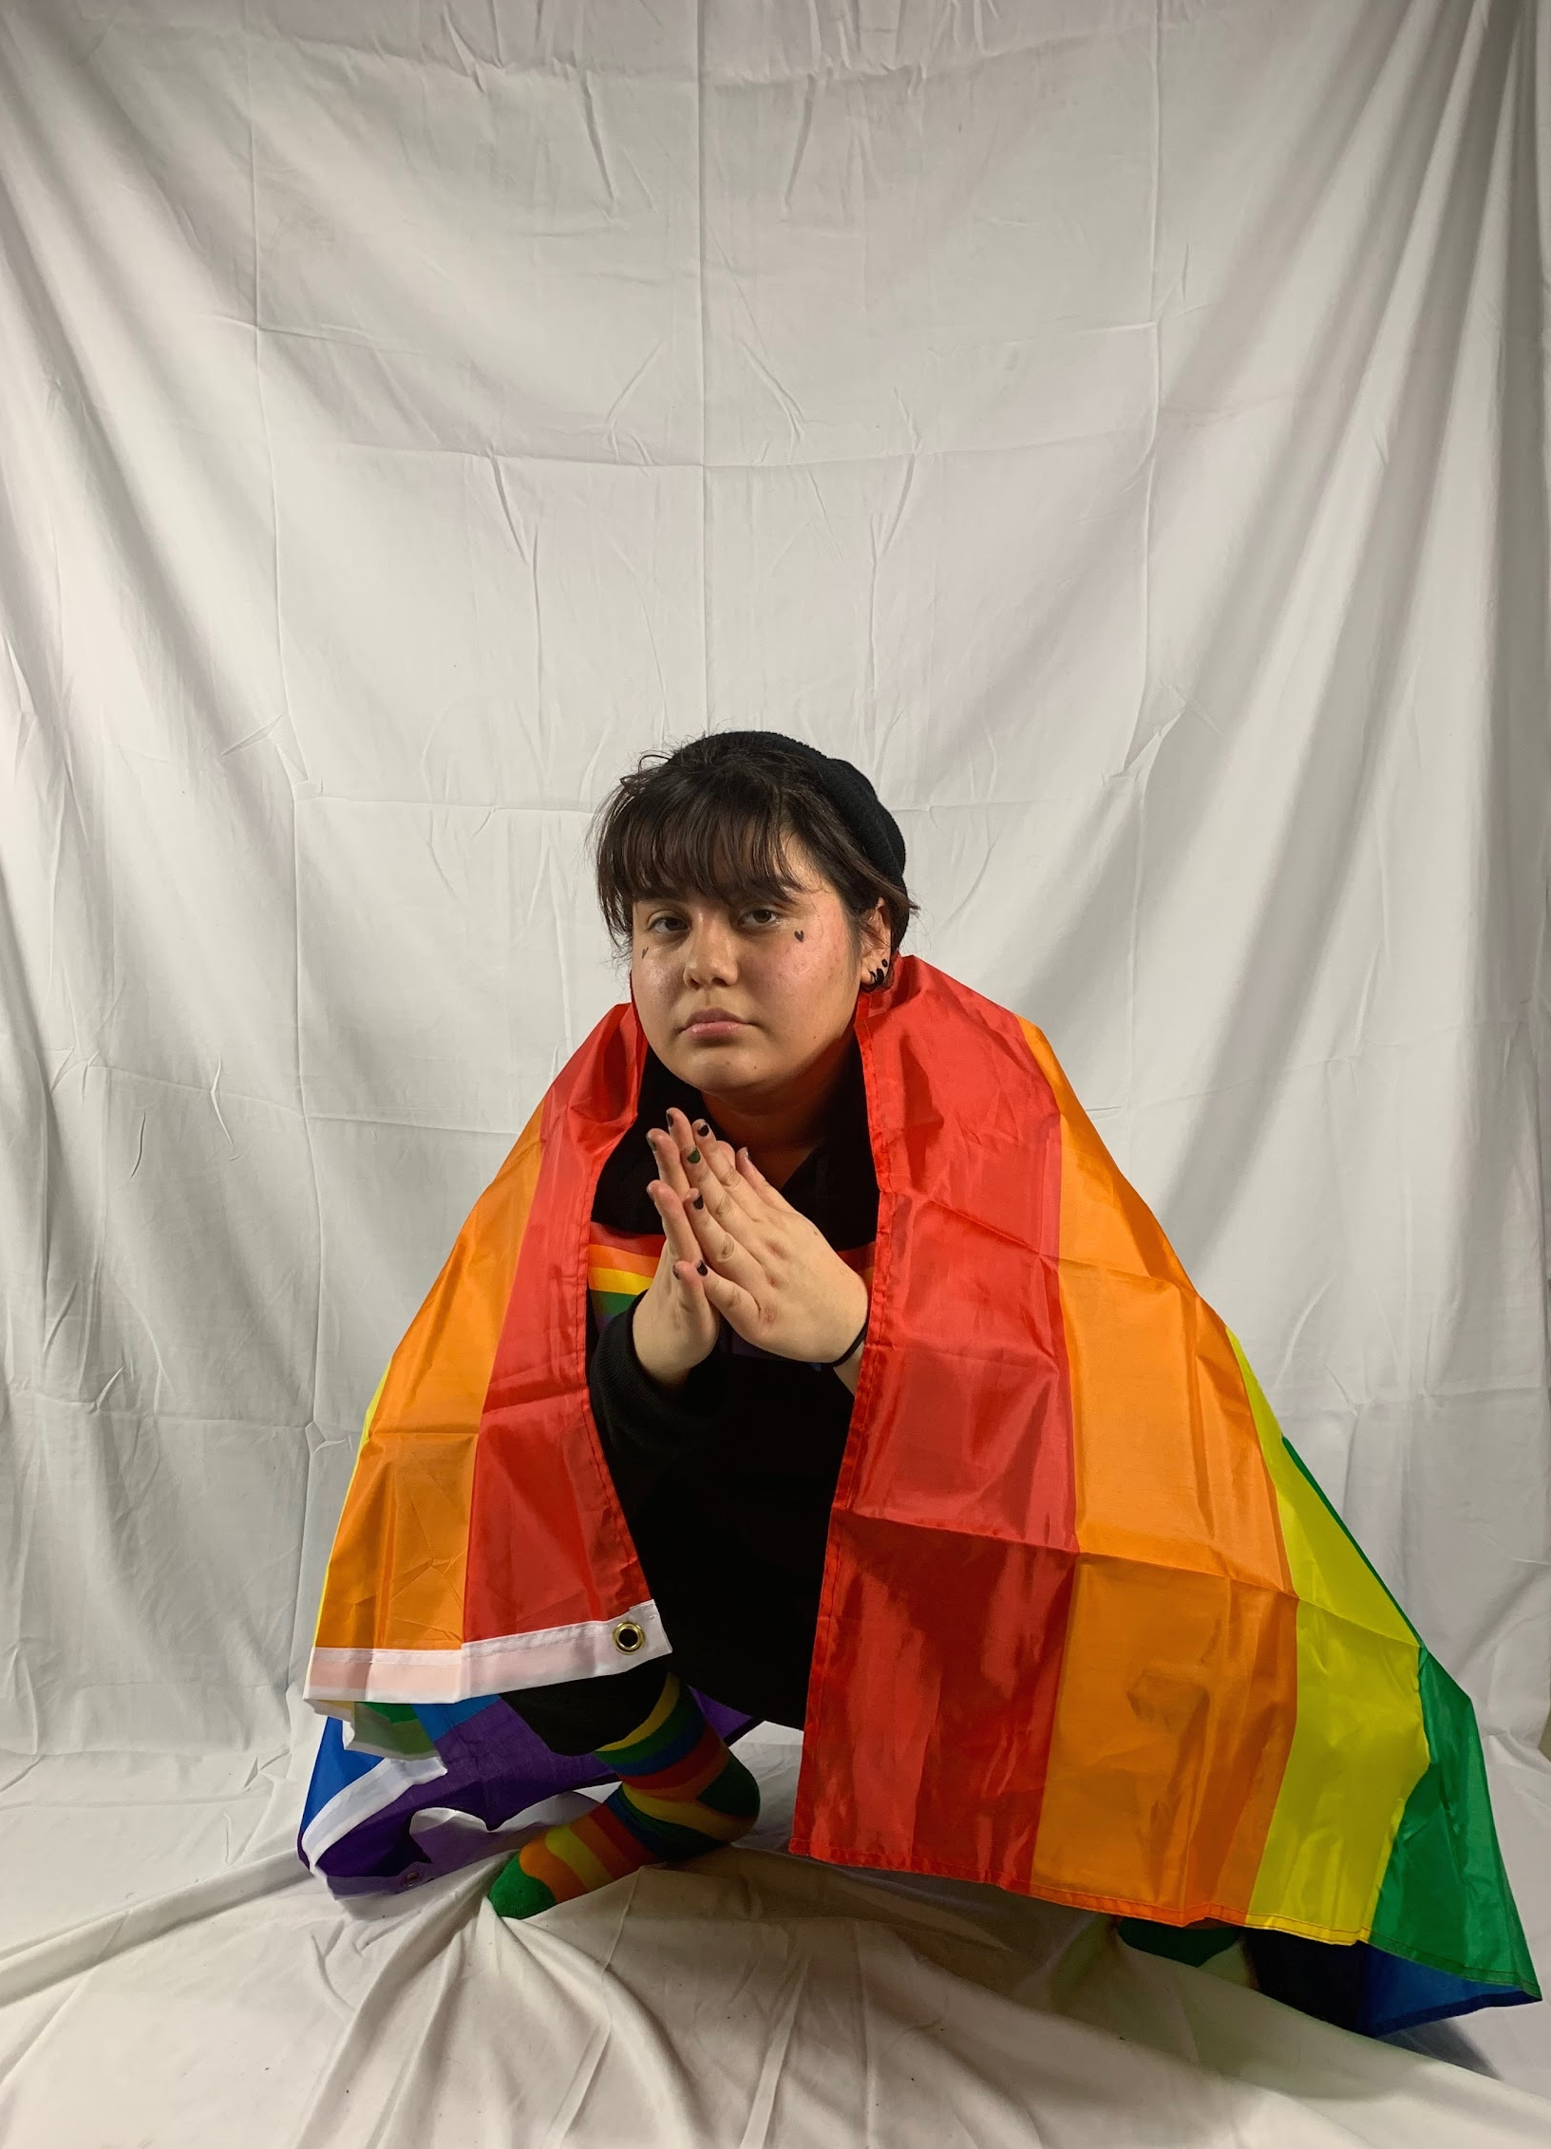
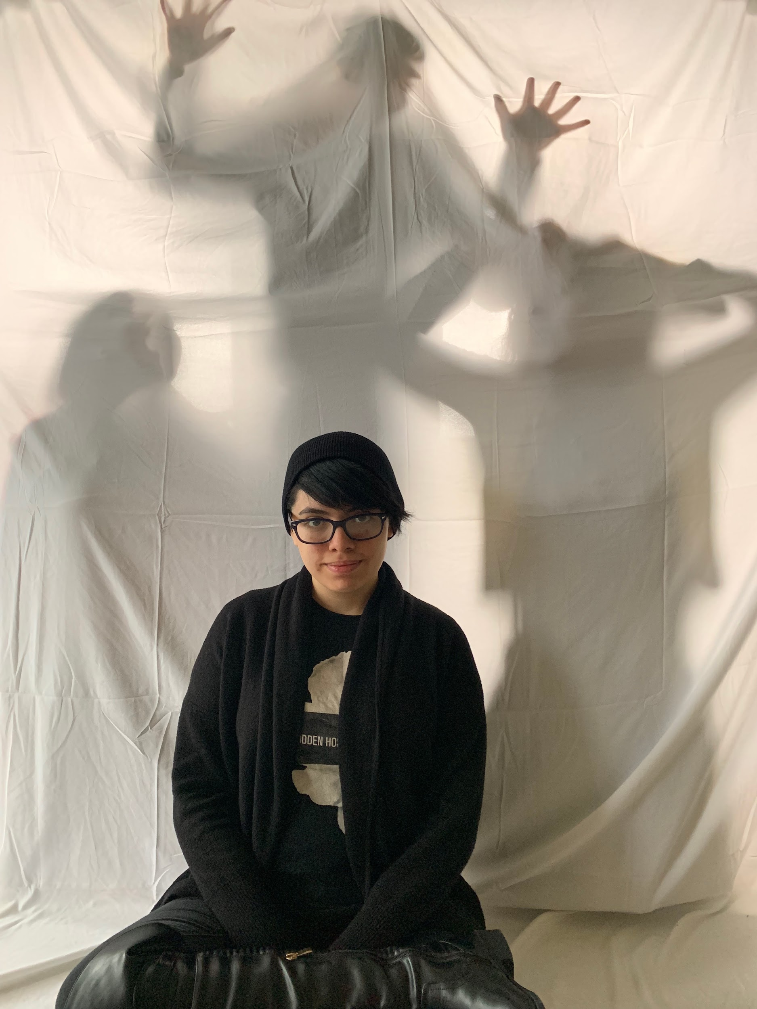
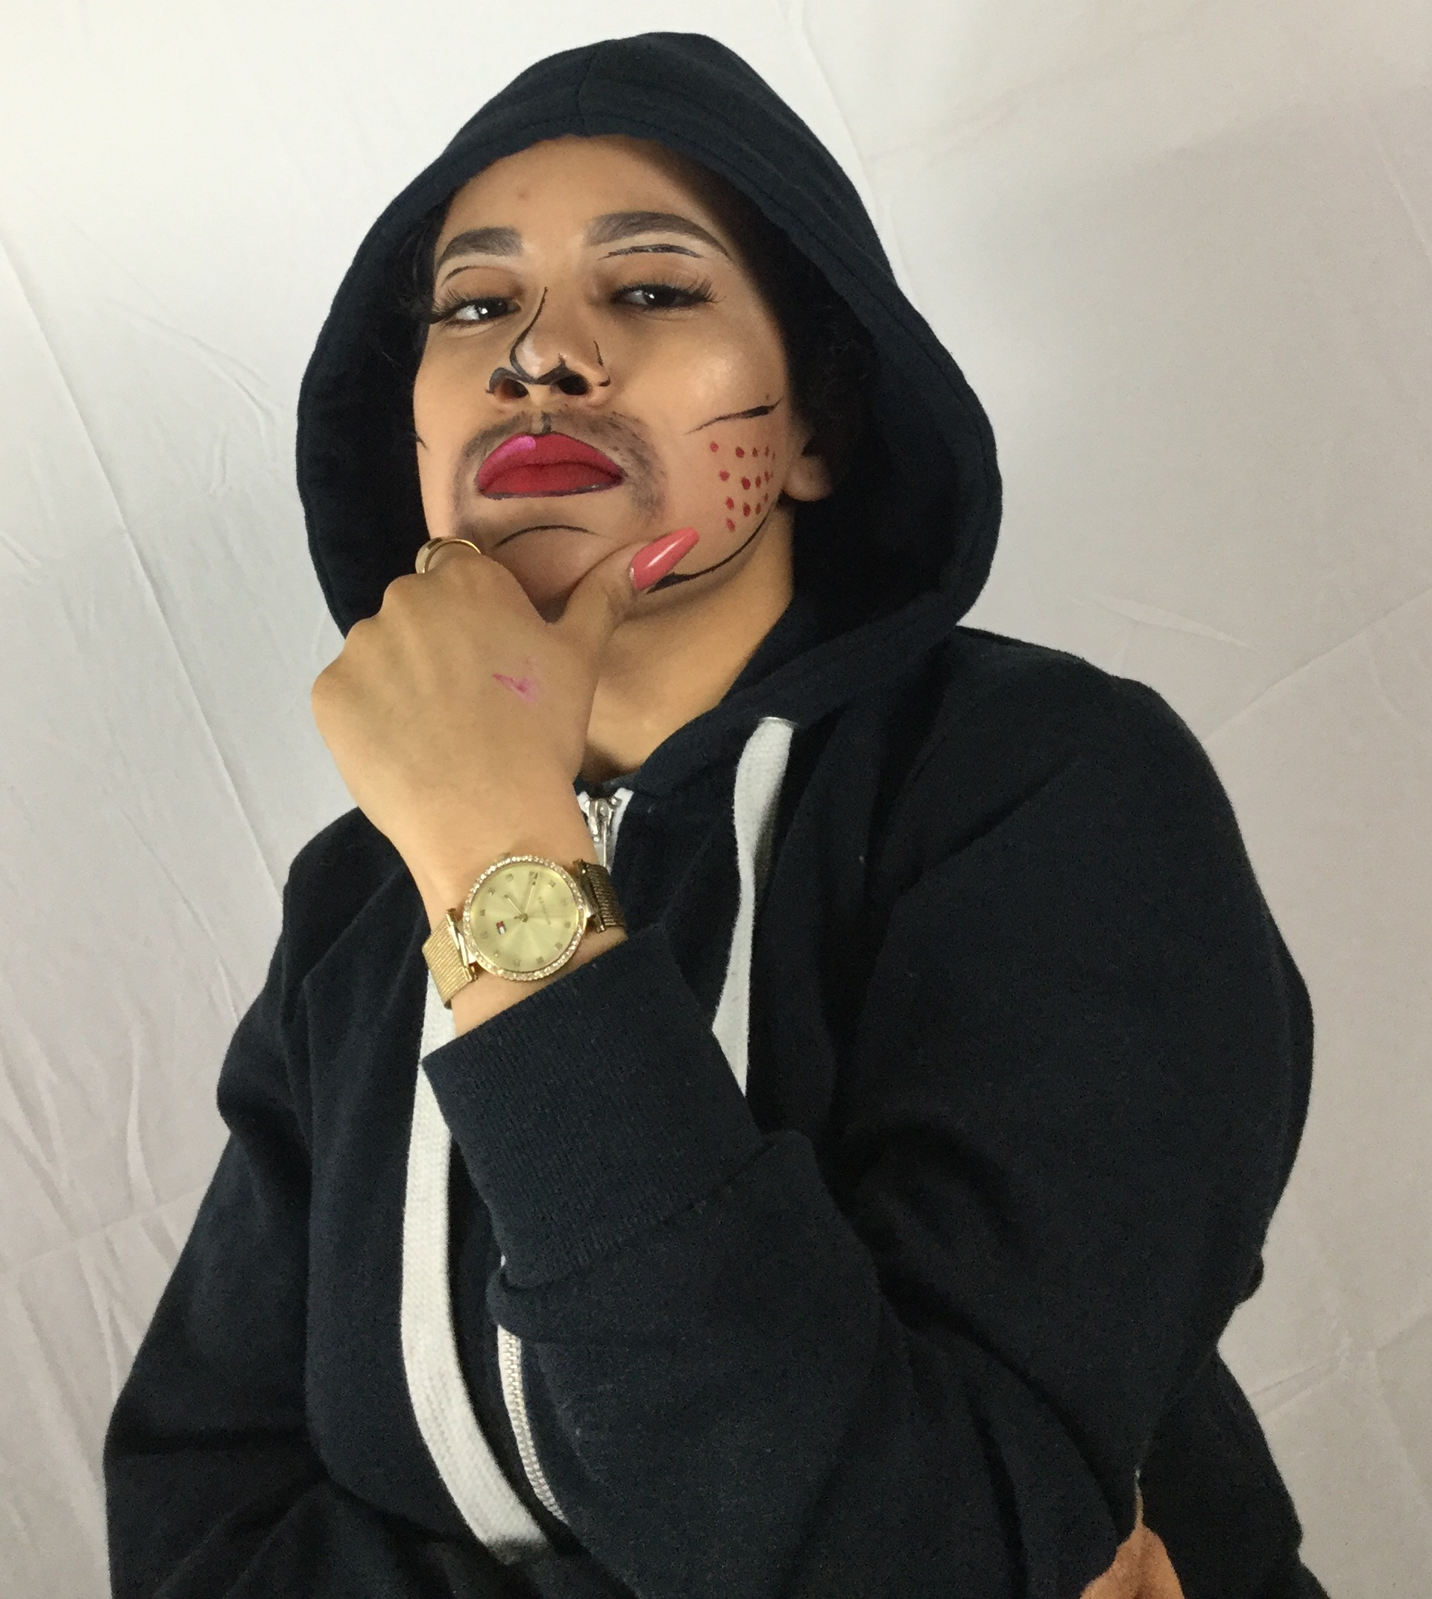
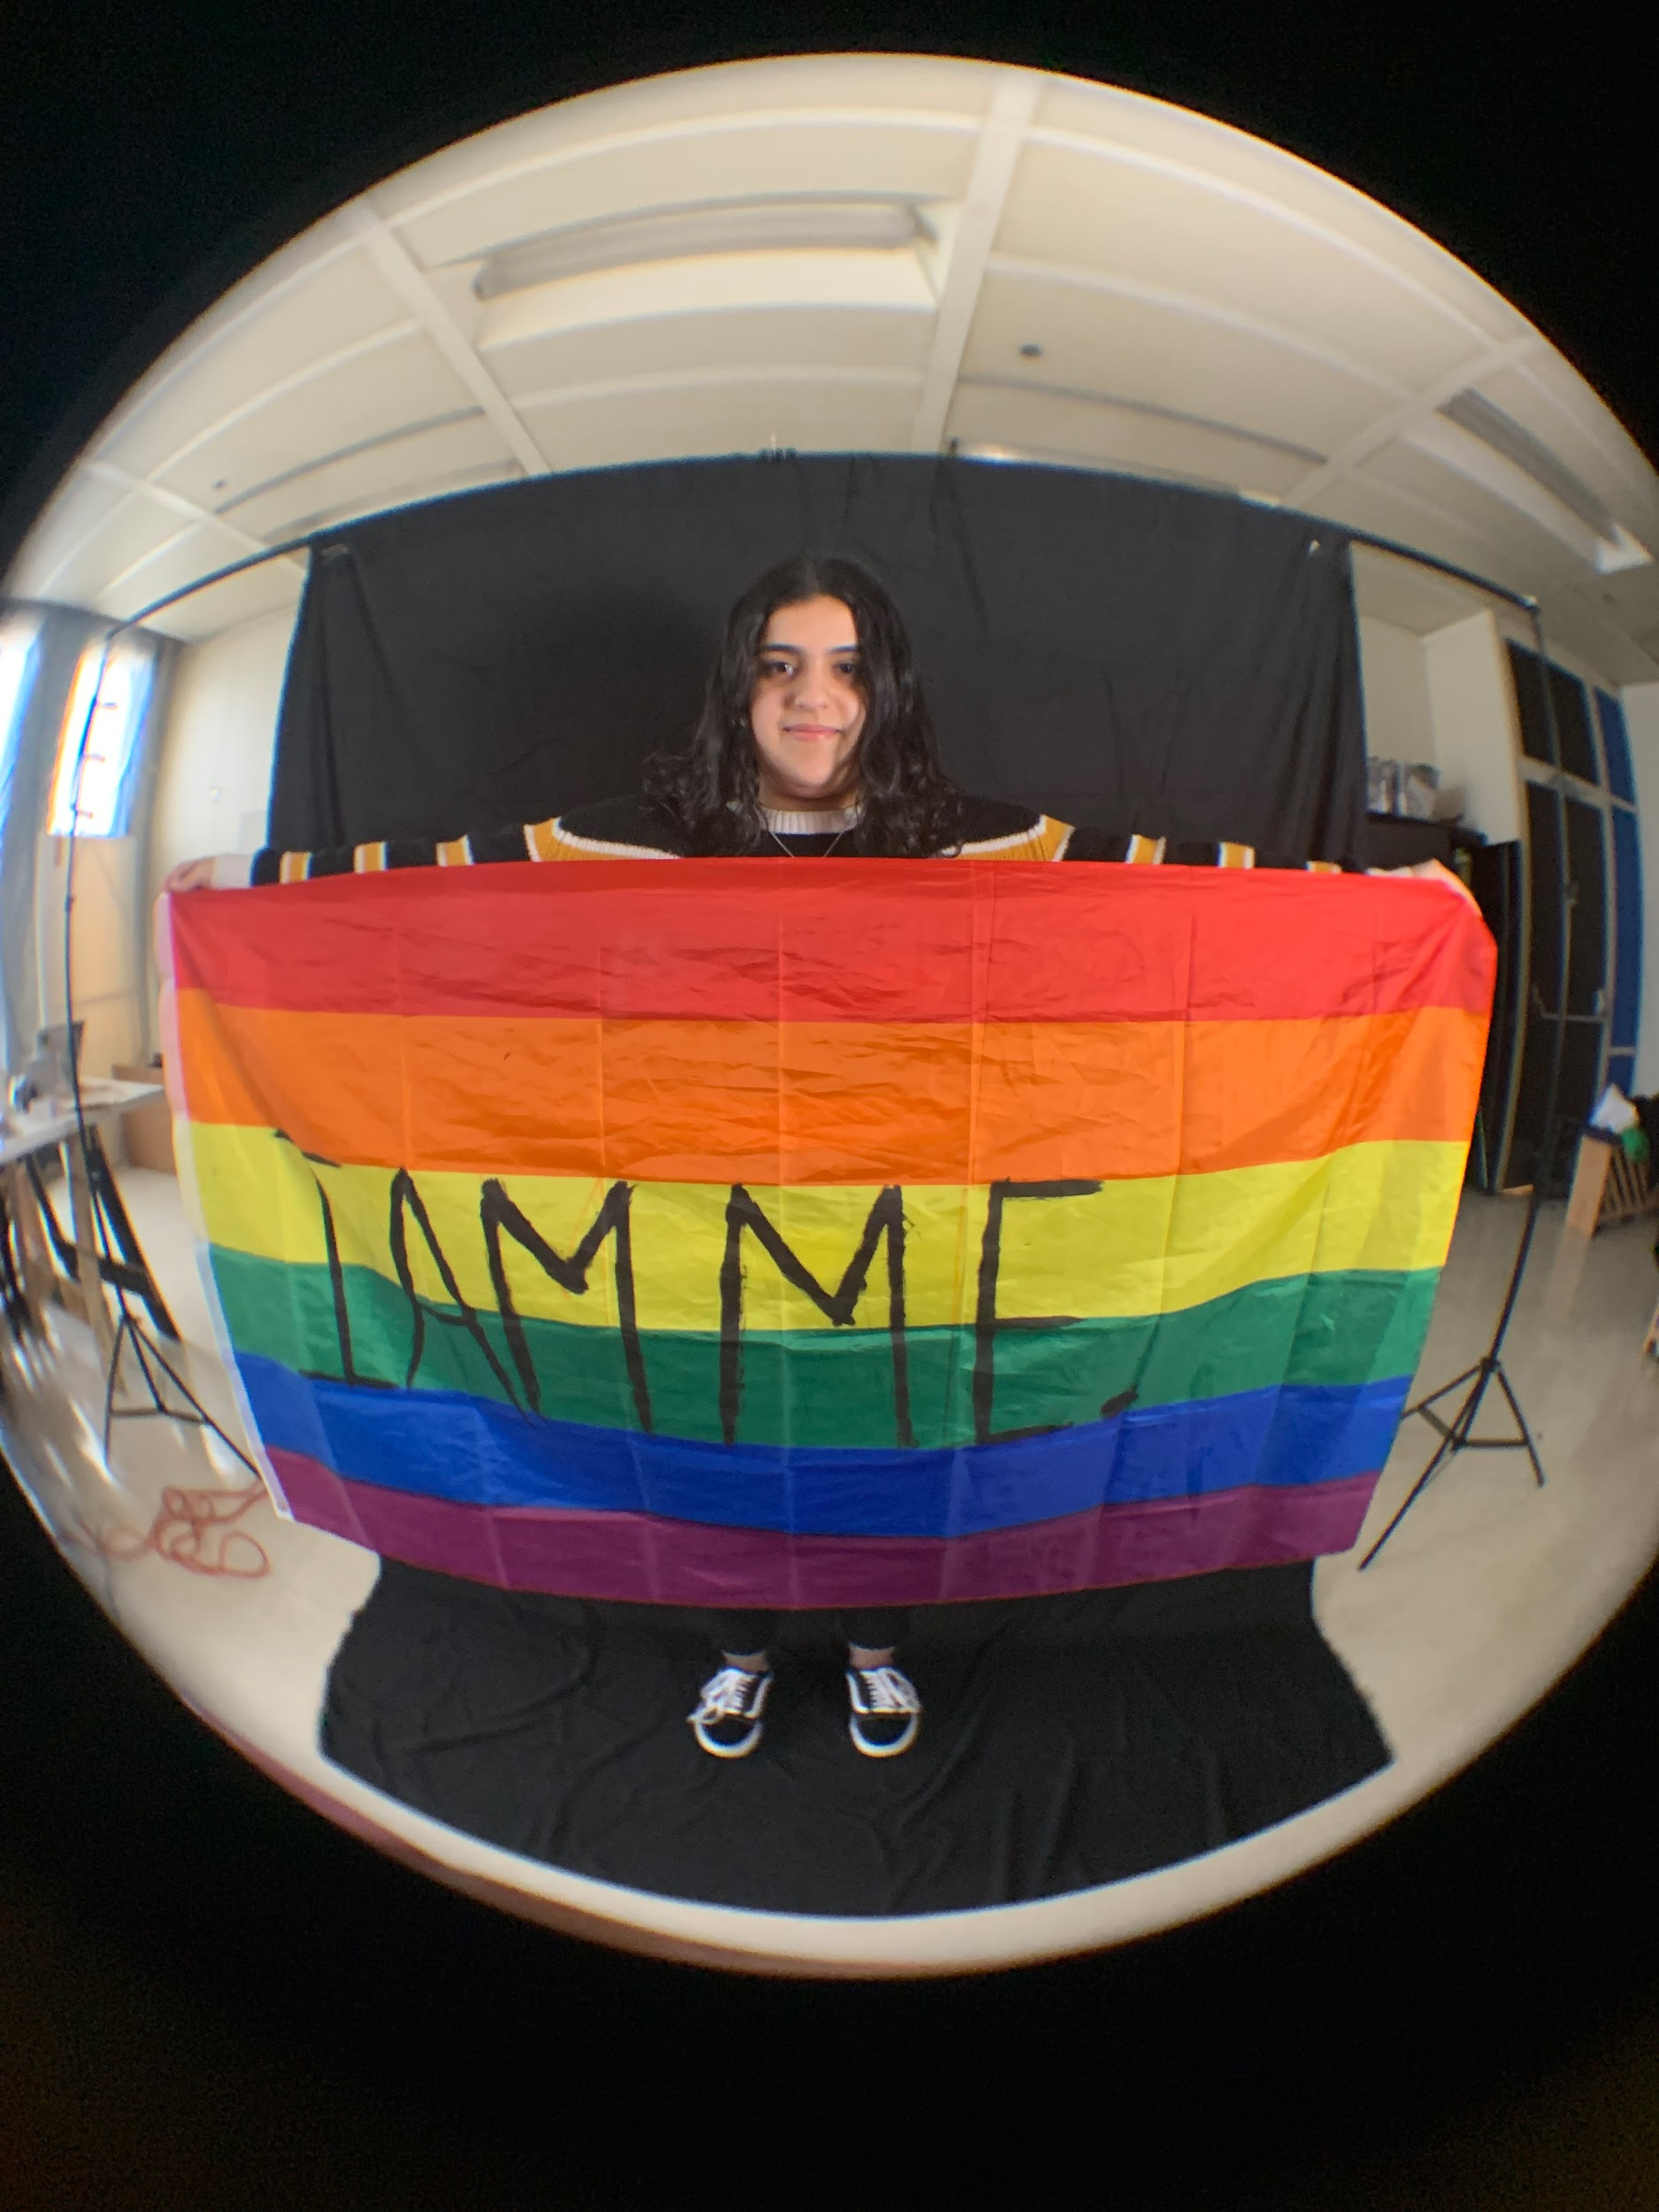
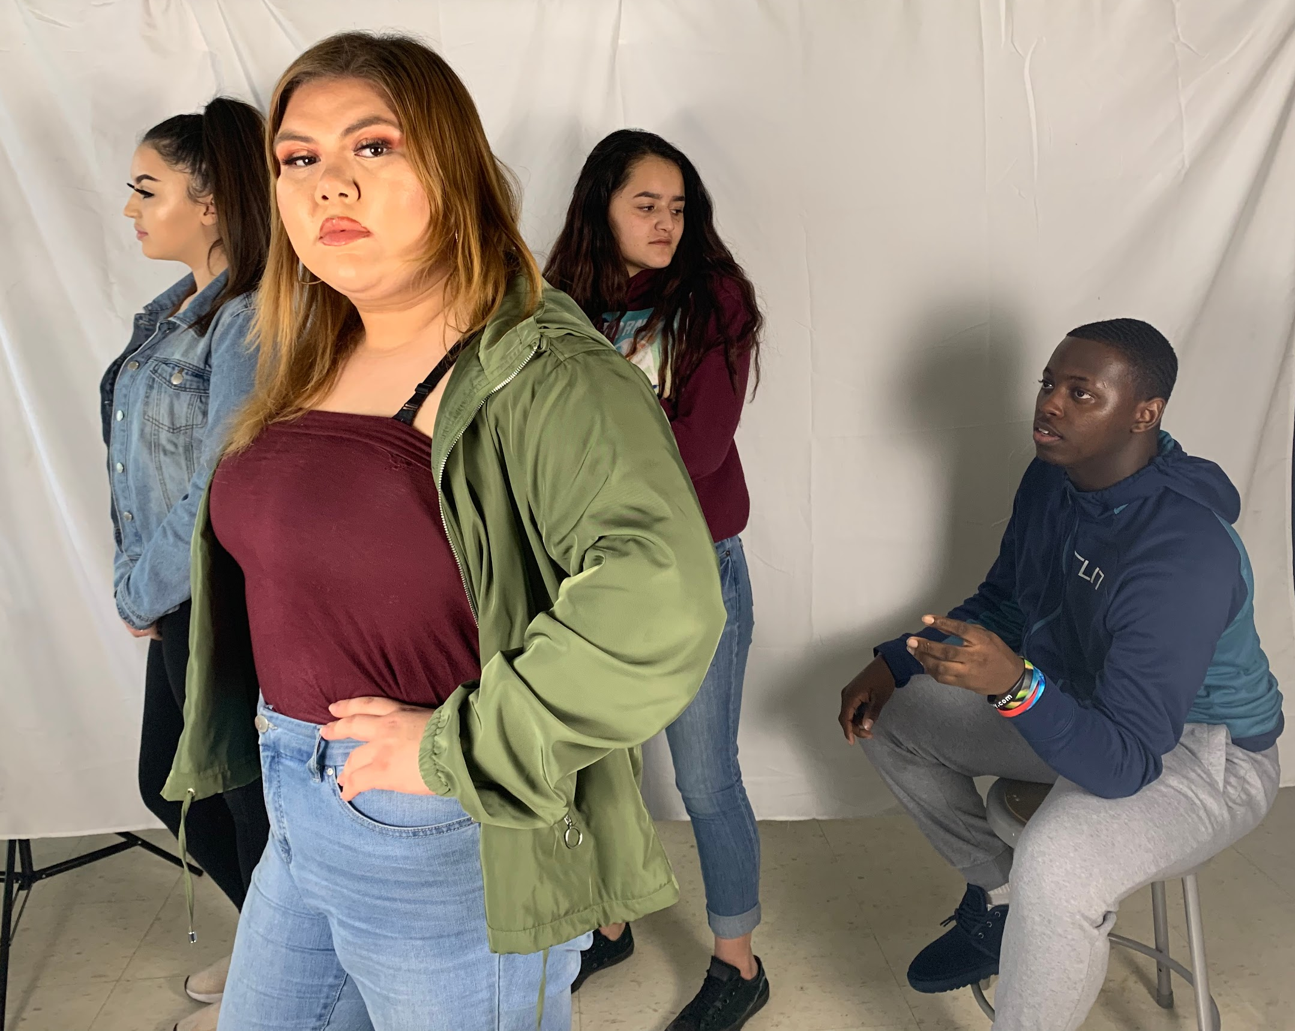
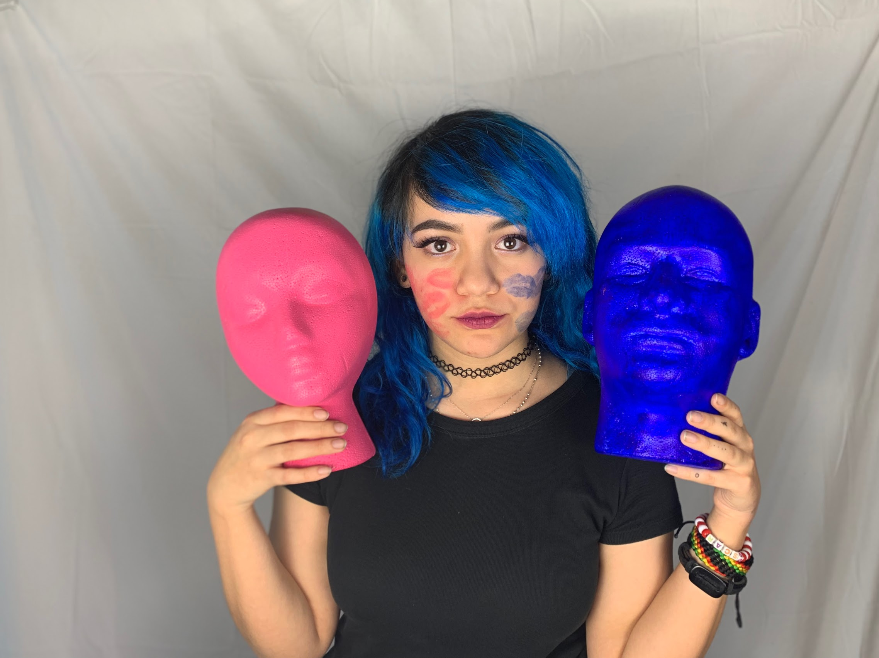
ARTivism II/III: Guerrilla Art Collective
Selfies 4 Justice, 2019: Portraits about empowered identities in the face of injustice

Slide 14
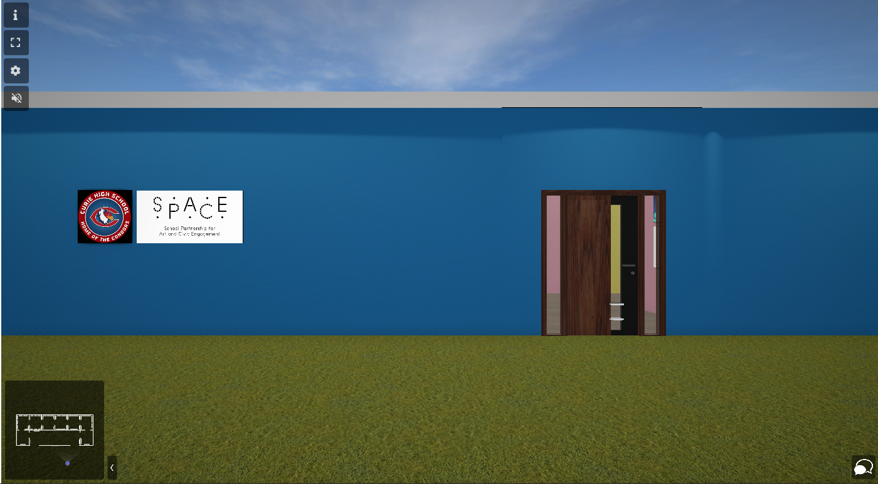
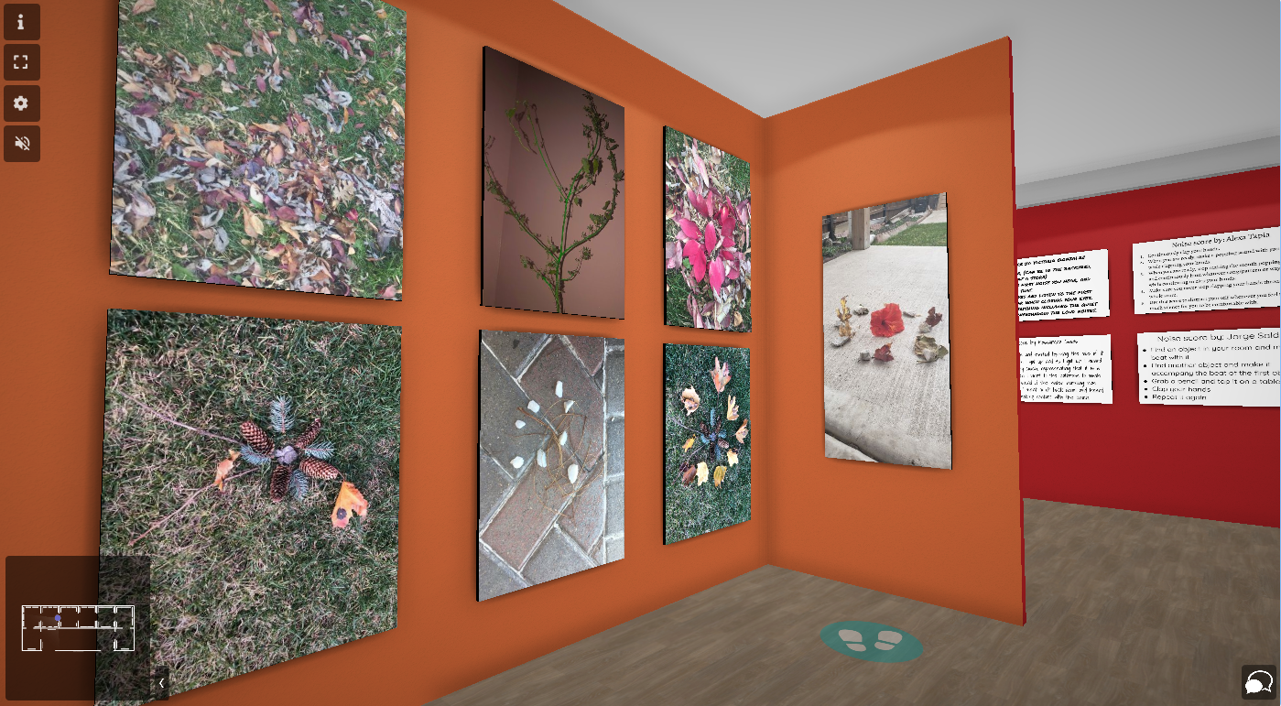
ARTivism II/III: Guerrilla Art Collective
A virtual reality exhibition by
The Guerrilla Art Collective
of Curie Metro HS in Chicago, IL. 2021.
During a year of virtual learning due to Covid 19, creating art presented a challenge. This challenge was met head on by the GAC.
Students created work that directly offers comfort not only to the creators, but to all visitors. The artwork is interactive and meant to help viewers engage in a self care practice.
#FreeYourThoughts
#SelfCareIsCommunityCare
#SelfCareIsResistance

Slide 15
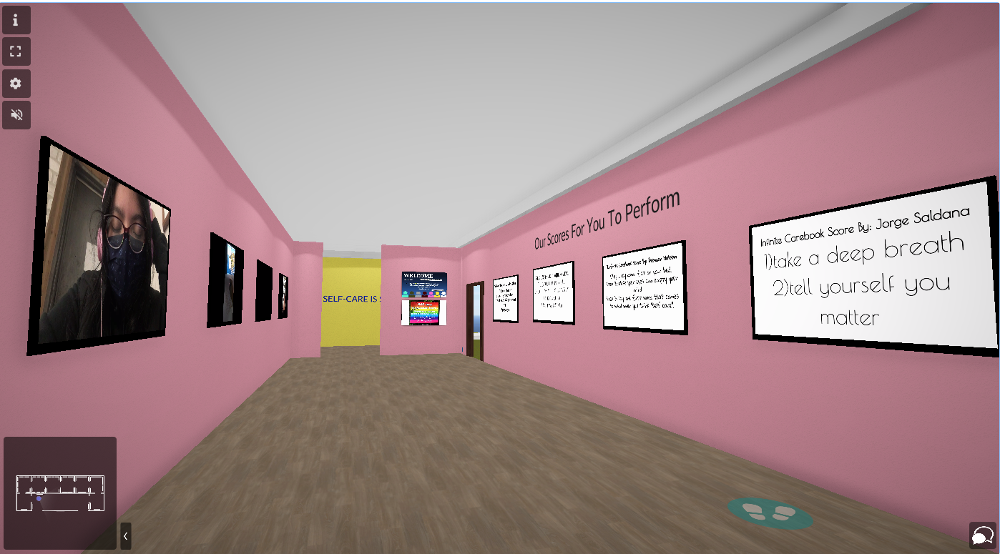
https://bit.ly/3eeKgH2
Clink link to visit this interactive virtual reality exhibition.
IG @GAC_CurieHS

Slide 16
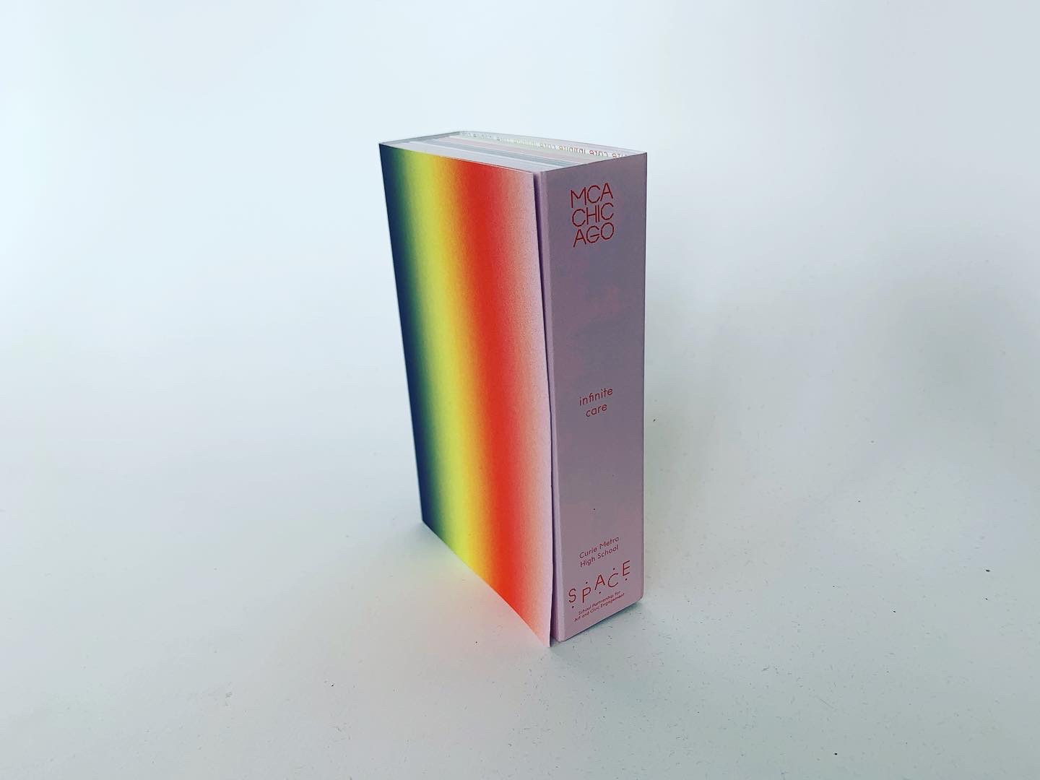
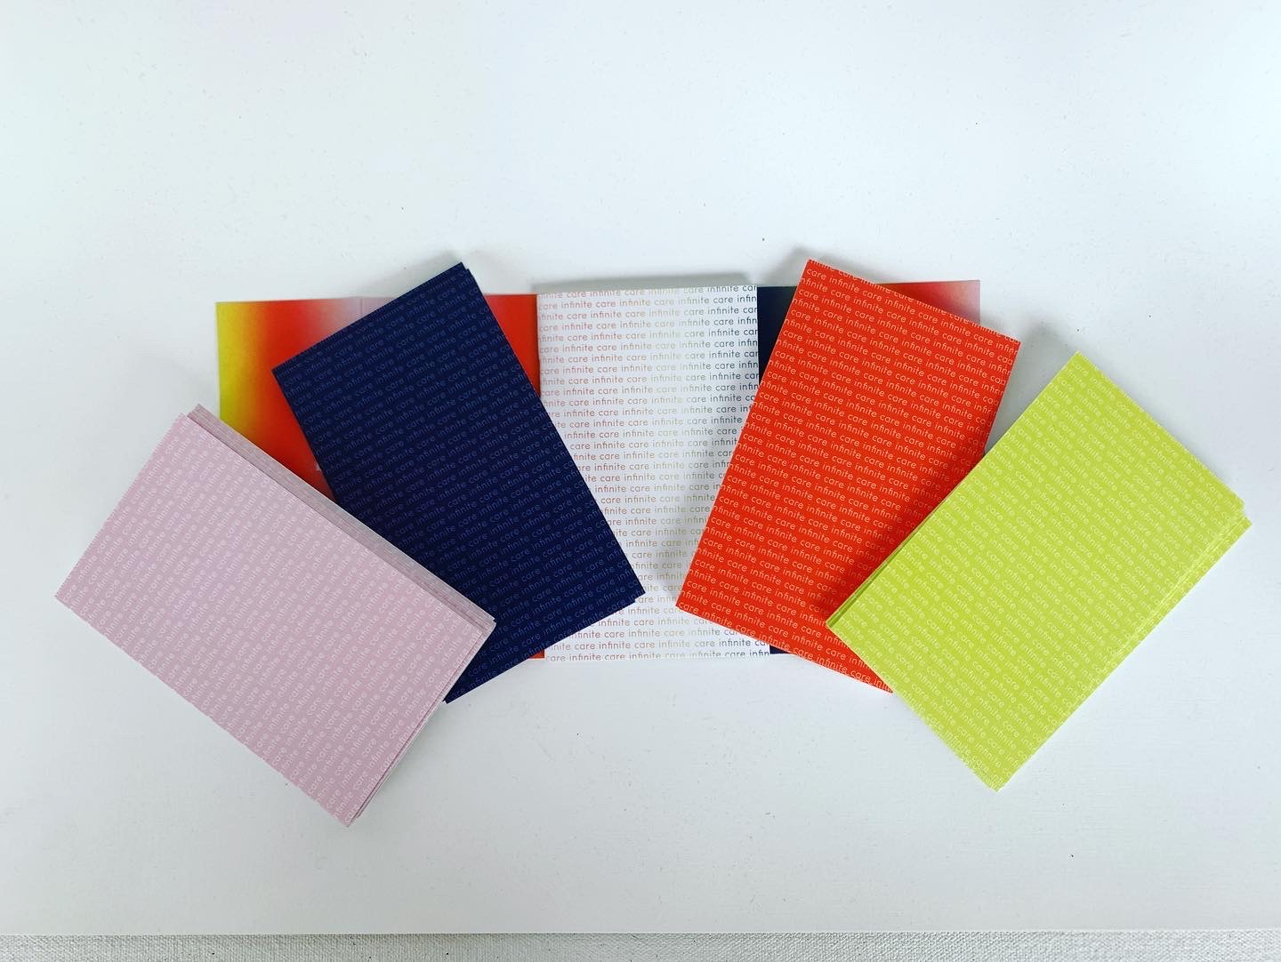
ARTivism II/III: Guerrilla Art Collective
The Infinite Care Deck created by the GAC class of 2021
Inspired by the performance scores of Andres L. Hernandez & A CanaryTorsi and the Oblique Card Deck by Brian Eno.
This card deck offers 4 categories of self care actions in the form of scores to be performed by the player.
Noise
Silence
Be Yourself Love Yourself
Take Care
#SelfCareIsCommunityCare
#SelfCareIsResistance

Slide 17
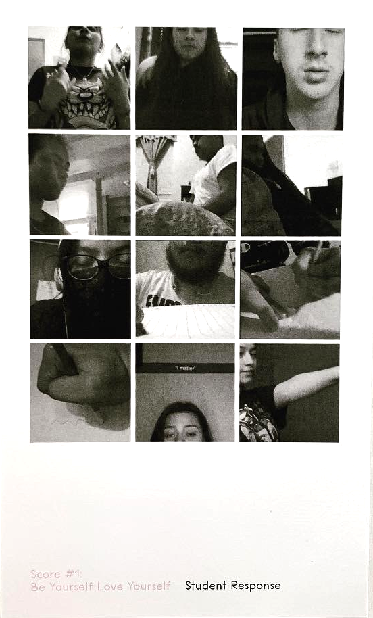
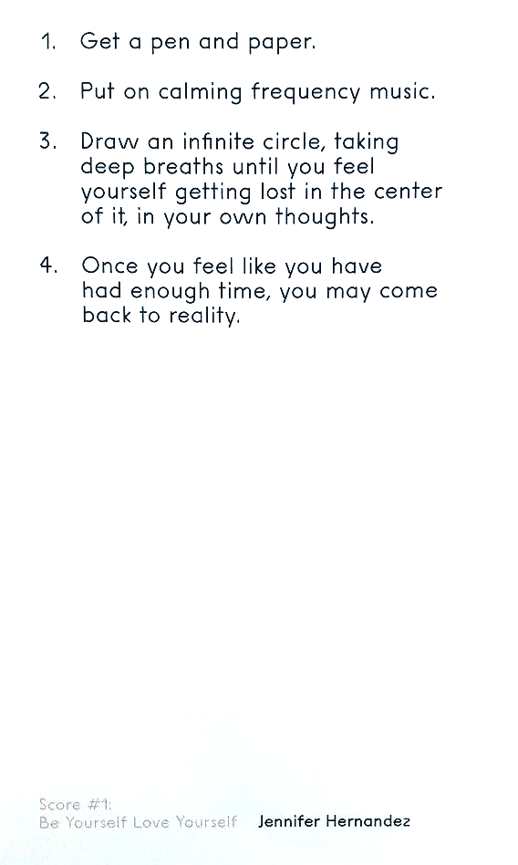
ARTivism II/III: Guerrilla Art Collective
BE YOURSELF, LOVE YOURSELF

Slide 18
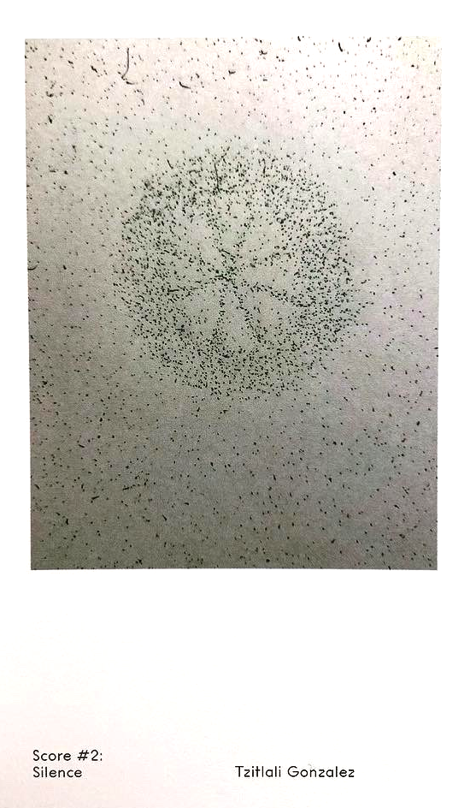
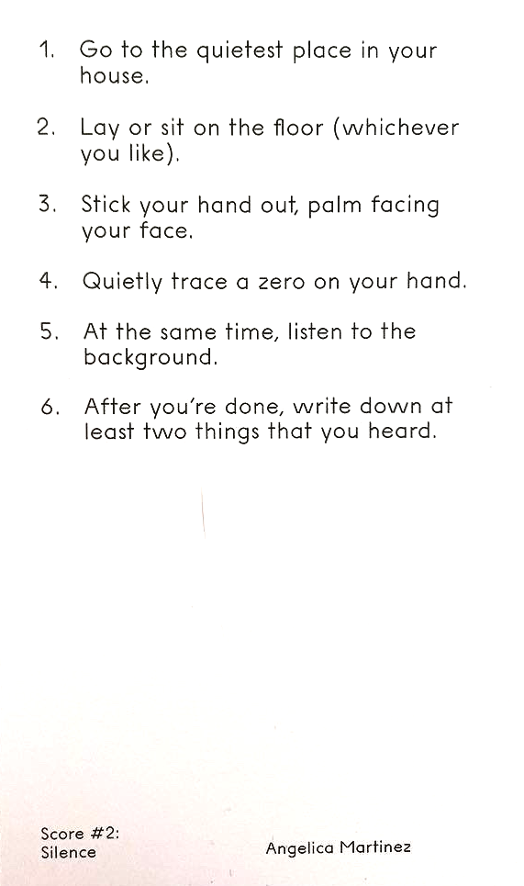
ARTivism II/III: Guerrilla Art Collective
SILENCE

Slide 19
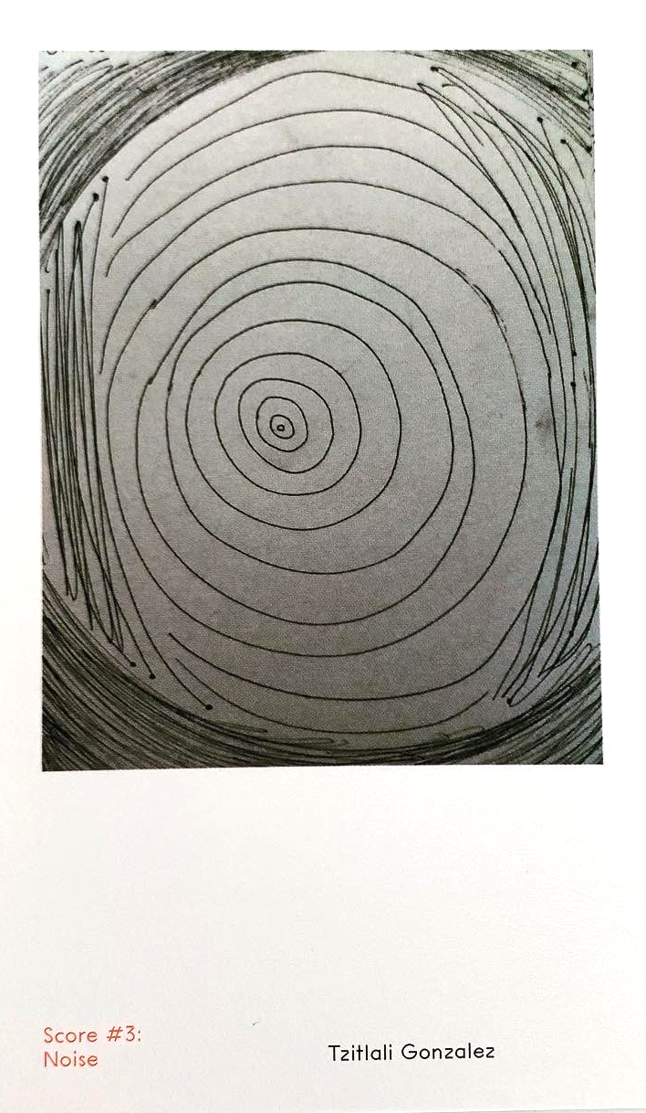
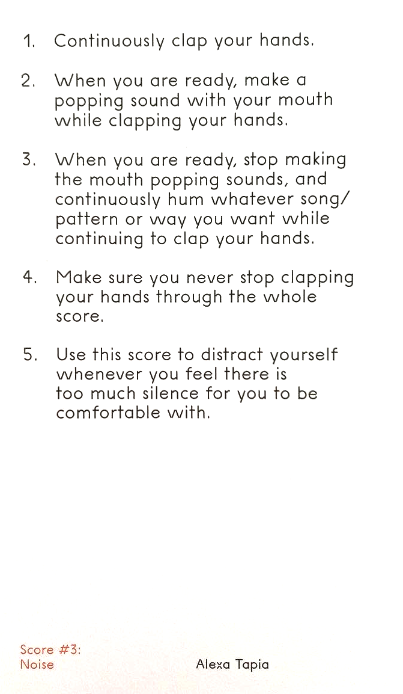
ARTivism II/III: Guerrilla Art Collective
NOISE

Slide 20
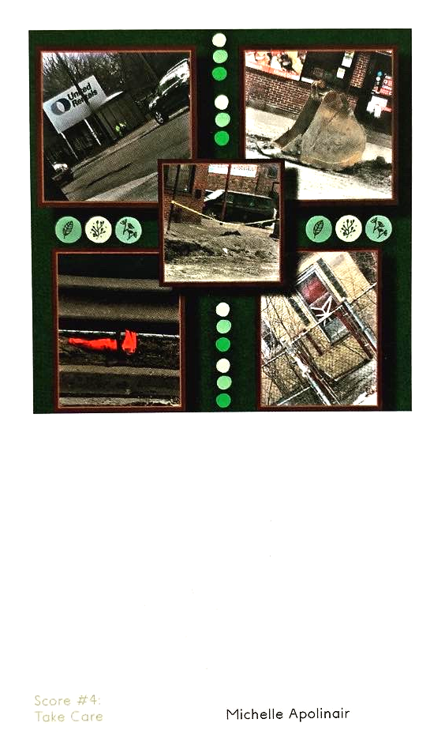
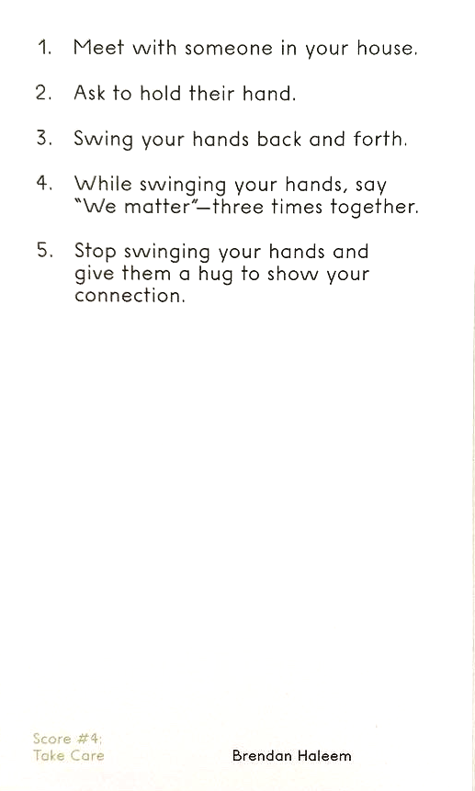
ARTivism II/III: Guerrilla Art Collective
TAKE CARE

Slide 21
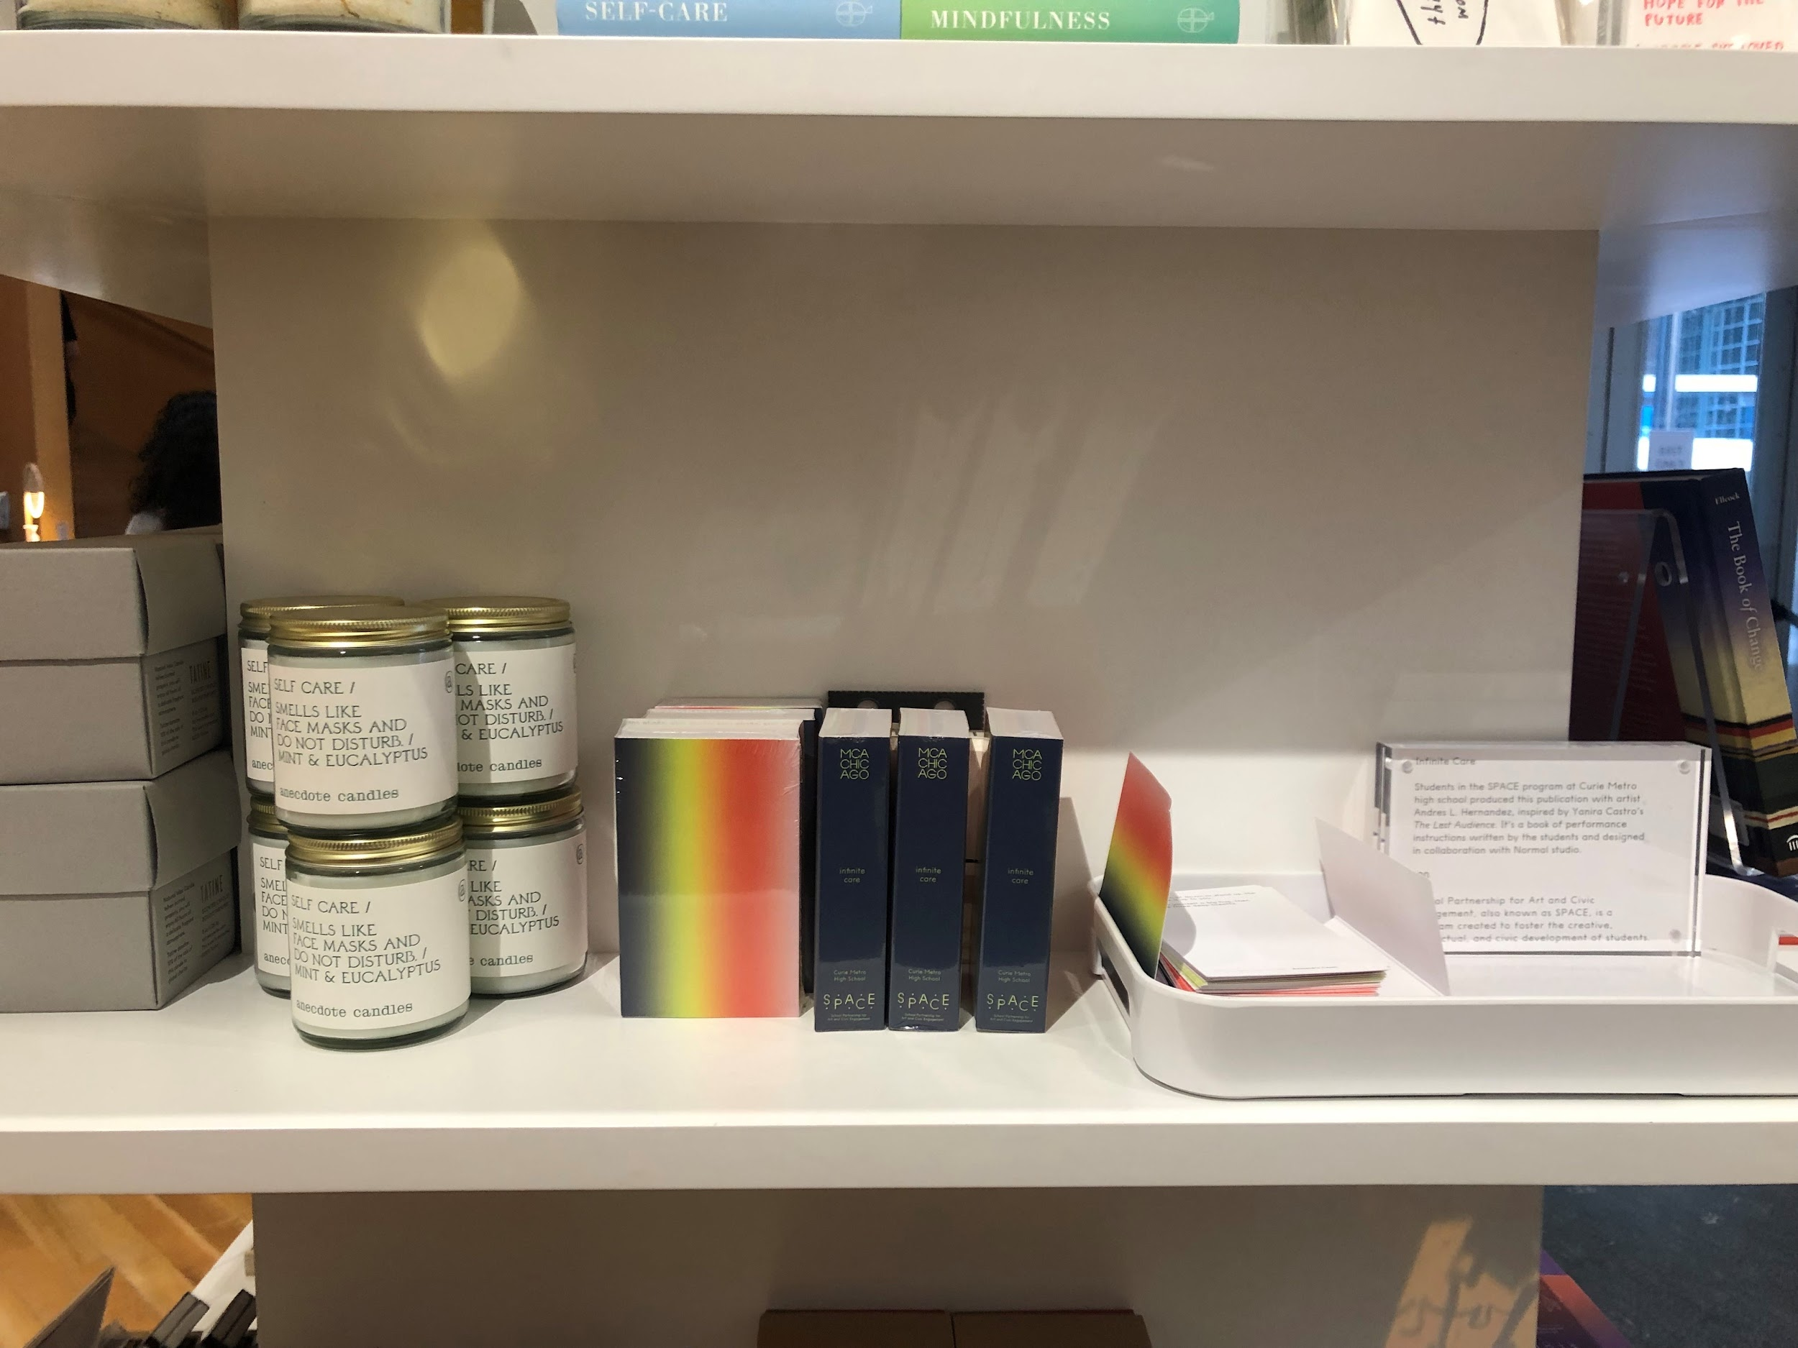
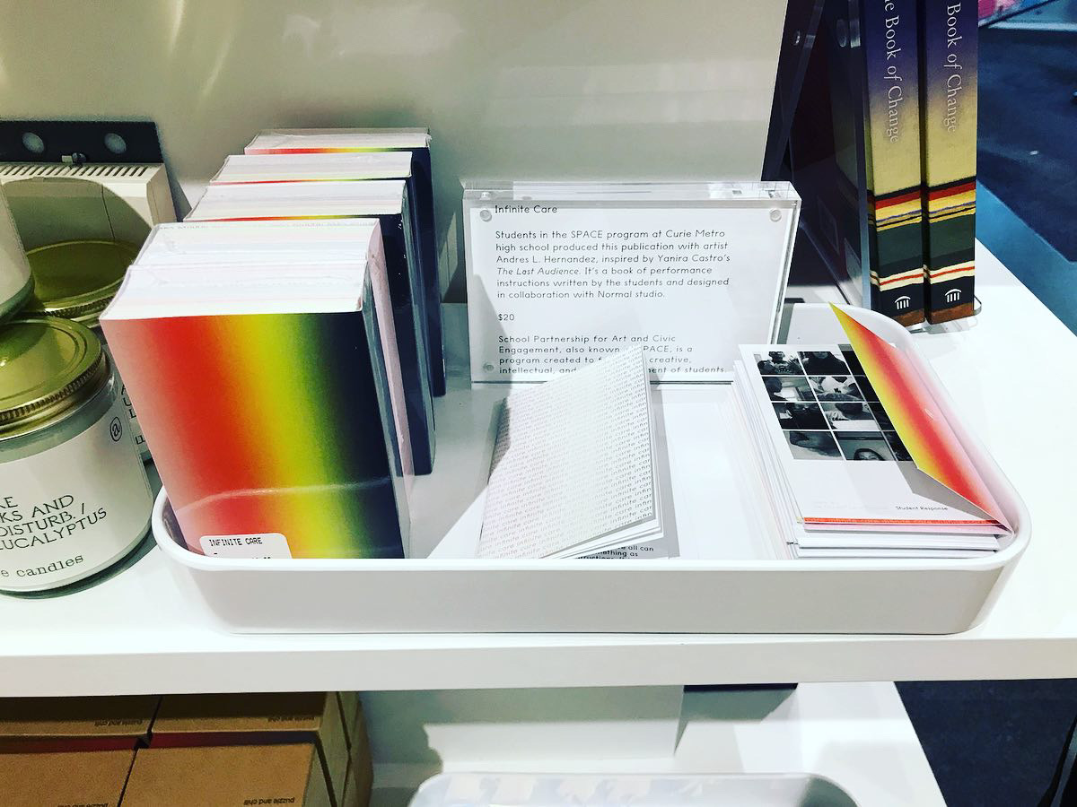
ARTivism II/III: Guerrilla Art Collective
The Infinite Care Deck is on sale at the MCA Museum store during the 2022 exhibition season. We are working on making it available for the Curie Community.

