Slide 1
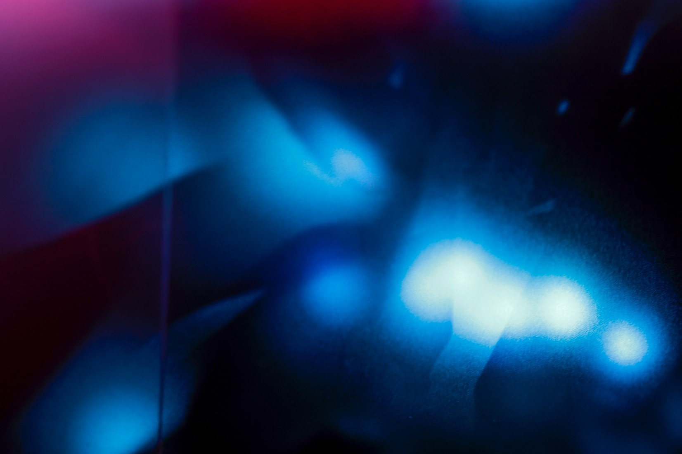
Immersive Experience
Creating Alternate Worlds in Installation Art
Theoretical musings in Studio Xanoi with Diana Thater
Valerie Xanos, 2016

Slide 2
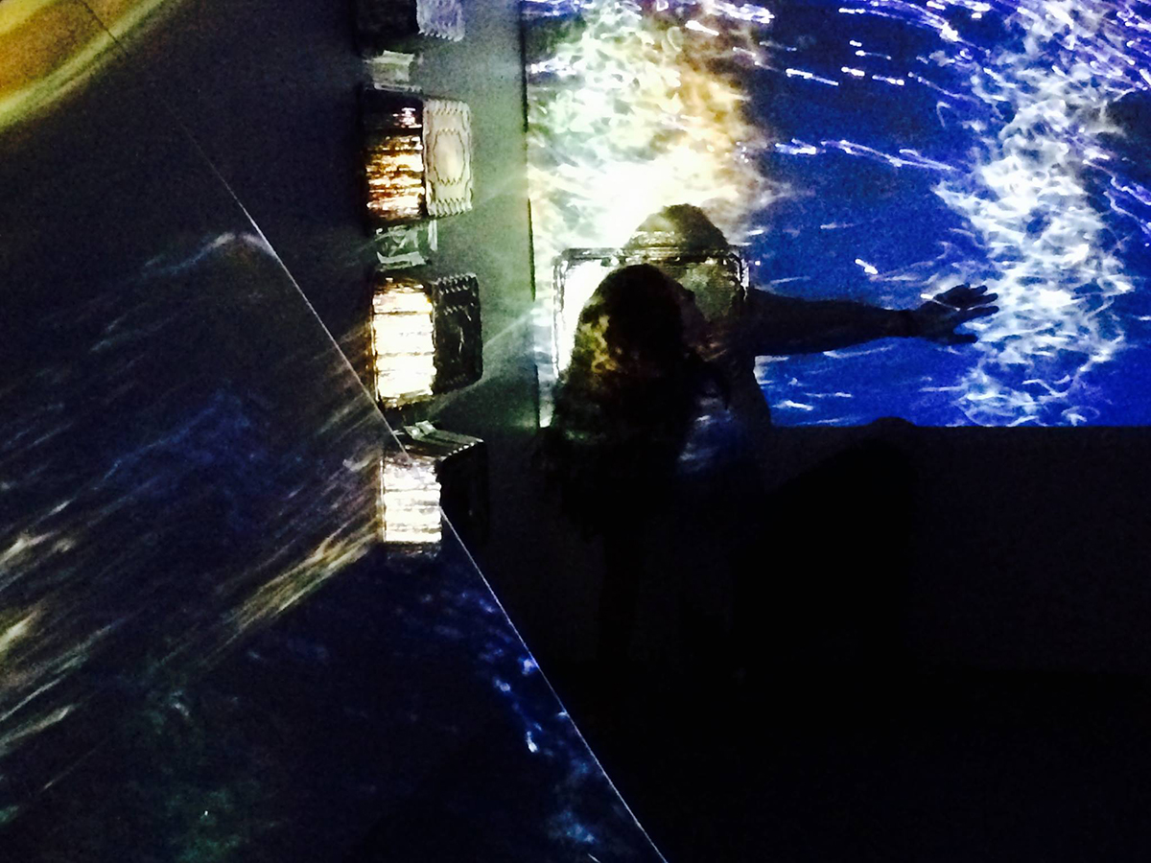
I live with a health condition that affects how I interact with the world. I am photo-sensitive, which means that light makes me sick. Very sick. I have not safely experienced direct sunlight since 2001. This photosensitivity also includes many kinds of artificial light. Imagine living in a world of darkness. It provides a lot of challenges as well as interesting experiences. I am not going to write about the illness, because it is NOT the focus of my work. I am not interested in making art about being ill.
Valerie Xanos, The Sublime Light and Dark; An Experiment in Disrupted Projection, Digital Projections 2016
Notes:
Insert images from VX photos

Slide 3
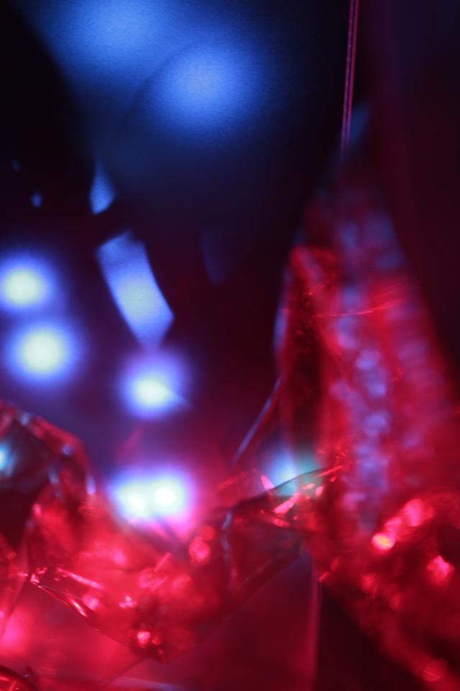
Rather, this body of work is about the relationship I have with light and dark as a result of this photosensitivity. My positionality to light and dark is psychologically complex. Photosensitivity leads to hypersensitivity which leads to hyperawareness and the position of being lost in an alternate world. In this alternate world, light is toxic, representing sickness, pain, and fear. Yet memory sensations of light signify warmth, energy, freedom and adventure.
Valerie Xanos, Untitled from ‘Alternate Dimensions - Through the Wormhole’ Series, Digital Photograph, 2016
ALTERNATE WORLD
Darkness is similarly polarized representing safety, comfort, solitude, freedom and a defense against the light. Darkness can also bring with it sensations of isolation, restriction, fear, and depression. Thus, the alternate world is simultaneously horrifying and beautiful, tragic and sensual, sinister and soothing. There is the perception of being small and held in awe of this larger dangerous world of light and dark. I am never in control, instead subject to the power of Nature. The “otherworld” is sublime.

Slide 4
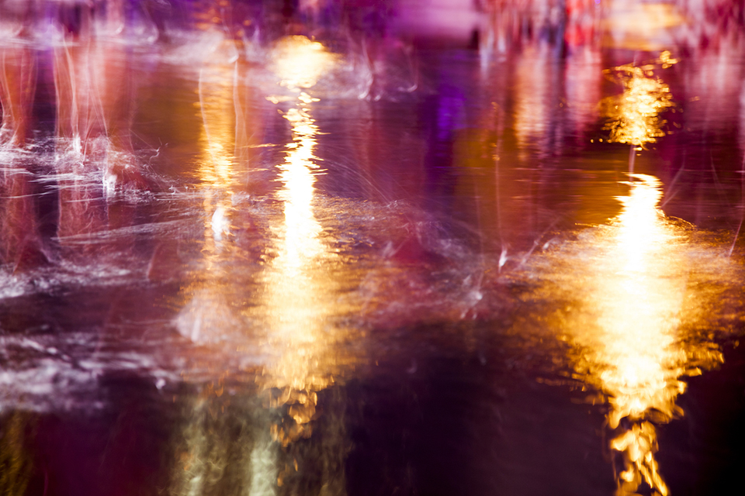
Valerie Xanos, Untitled from Water series,
Digital Photograph, 2016

Slide 5
Valerie Xanos, Untitled from Water series,
Digital Photograph, 2016

Slide 6
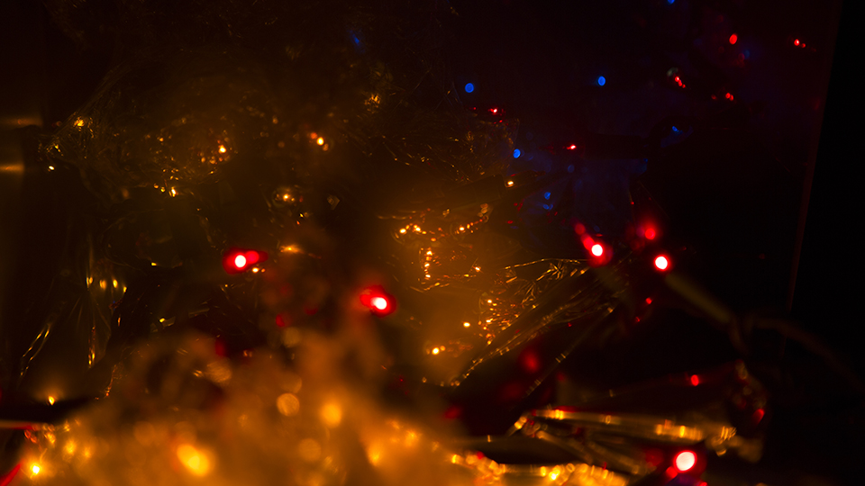
My work intends to explore and share my relationship with darkness and light. I use projections of still images to alter an architectural space in order to immerse the participant into an alternate world. A recent showing, The Sublime Light and Dark; An Experiment in Disrupted Projection used original digital photographs as timed projections in darkness. The photographs of light and reflections are taken in the darkest of night and expressed conflicting and sublime emotions about the nature of light and dark and my physical/psychological responses.
Notes:
Insert images from VX photos

Slide 7
Valerie Xanos, Untitled, Alternate World Series (A New Killer Star), Digital Photograph, 2016
Notes:
Insert images from VX photos

Slide 8
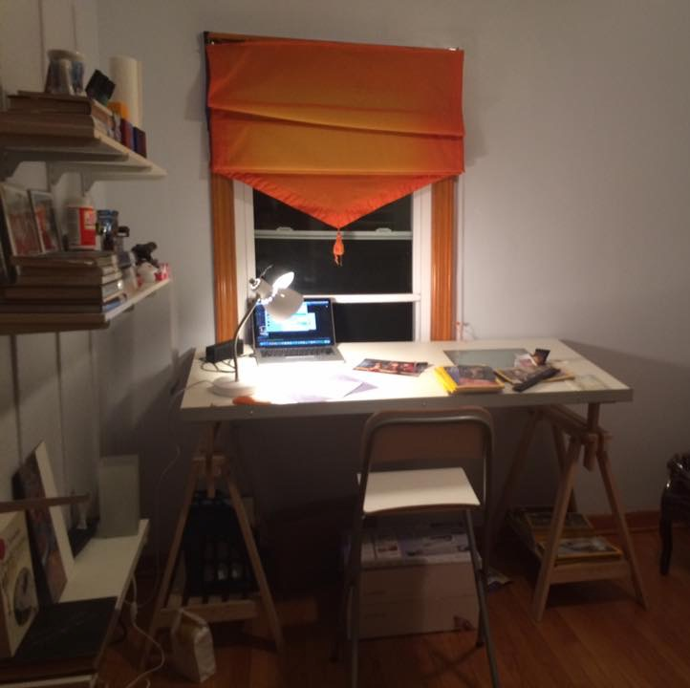
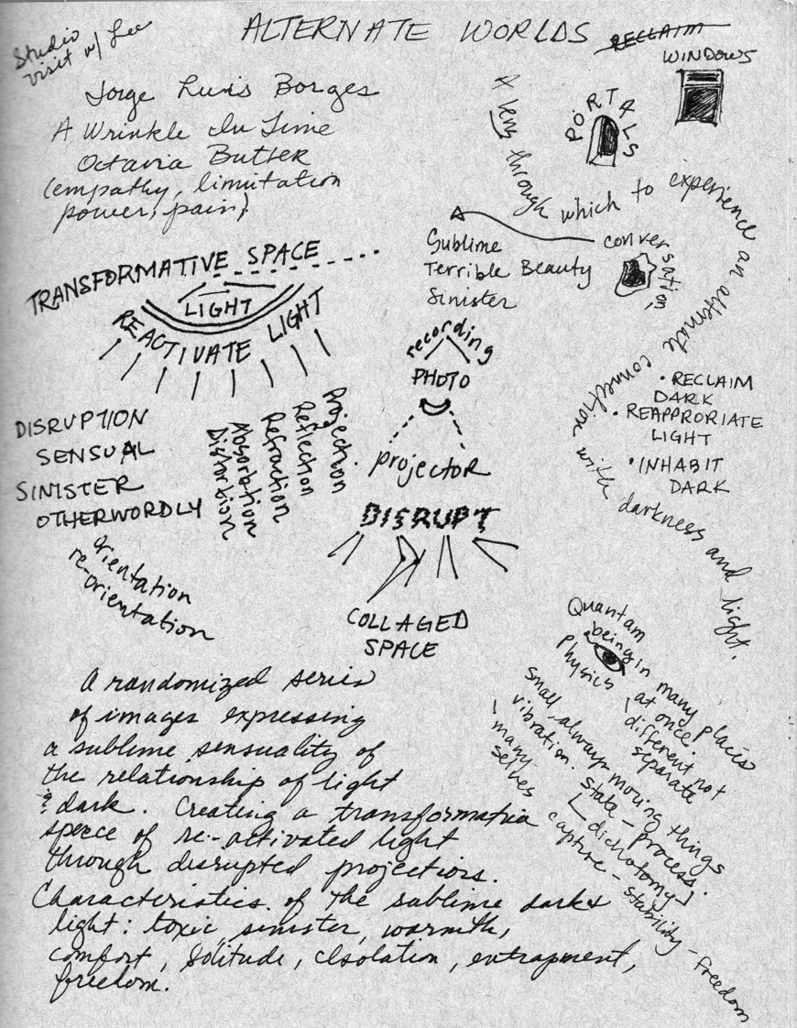
Mind Maps
Studio Xanoi is my workspace where I create images, take and develop photos, and explore installation concepts. It is a physical studio, but also the name I give to the creative space in my mind. I think of my mind as a form of physical architecture, thoughts inhabit that space much like people and objects in a room.
I use a thinking device to map out that space in my mind as I explore art ideas in relation to course readings, the art of Diana Thater, and my studio practice. “Mind maps” are a form of schematics that use diagramming, drawing, and writing to explore relationships among ideas in a non-linear form. Throughout this presentation I have presented mind maps as evidence of these thoughts and relationships.
Mind Maps often appear rather web-like or mimic layouts of architectural space that is metaphoric of what is happening in the space of the mind.
Thoughts on how immersive space is perceived by the viewer in my Light and Darkness projections

Slide 9
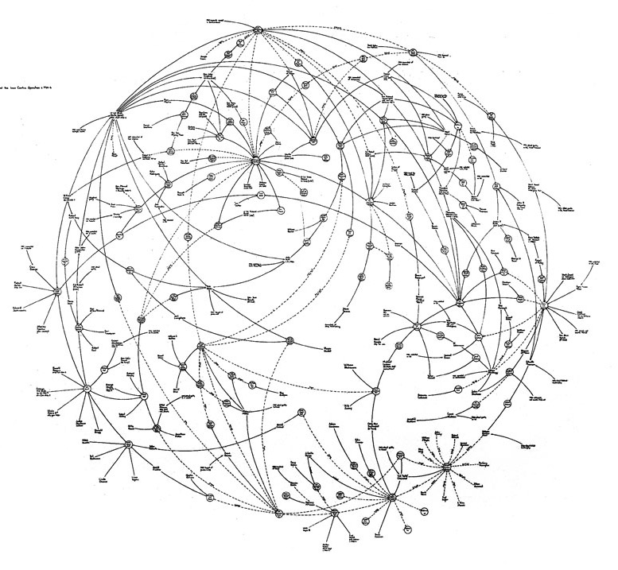
Mark Lombardi
The artist, Mark Lombardi, uses schematic mapping to document uses and abuses of power structures. While I’ve been using mind mapping long before I discovered Lombardi, I learned to appreciate his work as a form of art as opposed to just a thinking device.
Mark Lombardi was a New York artist who began working with mapping schematics in the early 1990’s. Lombardi got his information through intensive research and created the drawings to map out the power relationships he discovered. While Lombardi originally used his schematics as thinking devices for his research into political scandals, he discovered that they were artworks in their own right, according to gallerist Devan Golden, “The diagrams were more visually interesting than his paintings… they pulled together everything Mark was interested in – drawing, social/commercial interactions and their hierarchies, and politics – into a single pursuit.” (5)
His work was sought out by the FBI to research links between global finance and terrorism shortly after 9/11.
Mark Lombardi died in March, 2000 by suicide.
Mark Lombardi, Oliver North, Lake Resources of Panama, and the Iran-Contra Operation, ca. 1984–86 (fourth version), 1999, 63 × 82⅞ inches.
Notes:
Context about his life, intentions, and suicide.

Slide 10
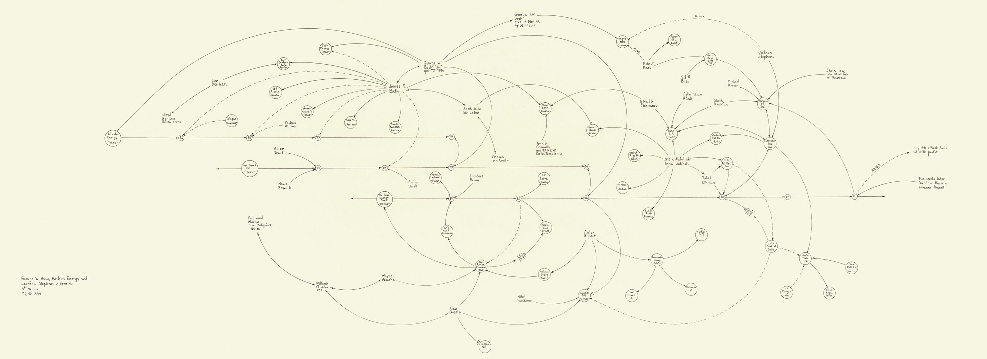
“The results are not only detailed slices of history, but also works of art — some looking like constellations of stars on a dark night, others swirling clouds of abstract lines and points.” (10 )
Mark Lombardi, George W. Bush, Harken Energy, and Jackson Stephens, c. 1979–90 (fifth version), 1999, graphite on paper, 24⅛ × 48¼ inches..

Slide 11
Bush, Harken, Stephens Detail showing Bin Laden connection
Notes:
Insert close up of lombardi map Bush… fade transition

Slide 12
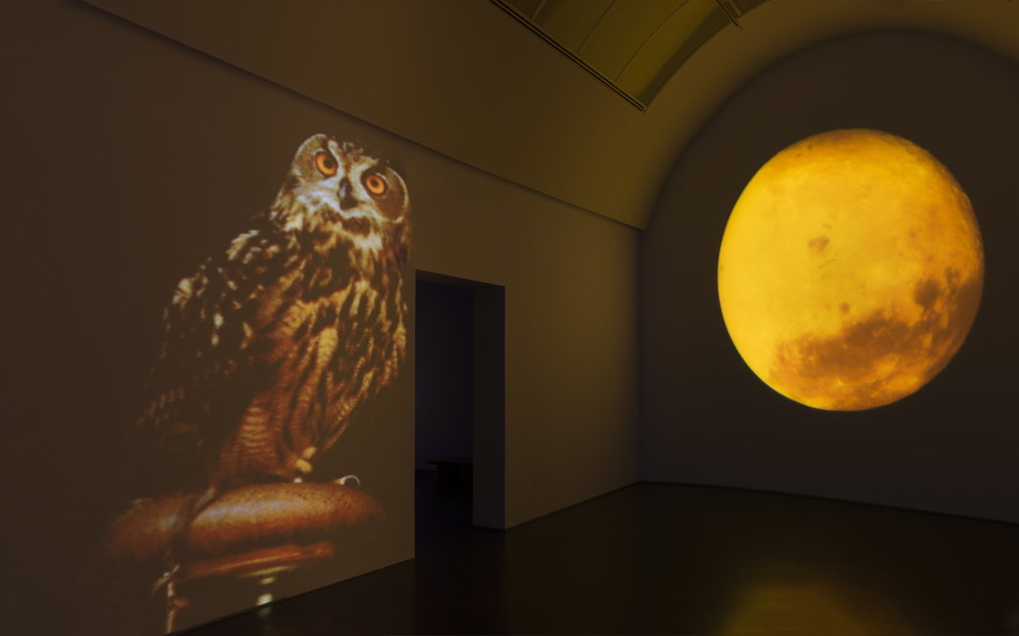
Diana Thater – Sympathetic Imagination
“No limit to the extent to which we can think ourselves into being of another. No bounds to sympathetic imagination.”
J.M. Coetzee

Slide 13
Diana Thater is an artist with whom I share a strong kinship regarding my own work. I decided to focus on Diana as she masters something that I am passionately exploring right now. In Sympathetic Imagination she creates immersive environments for the viewer to experience. The term “viewer” is misleading as it implies looking at something in front of one’s eyes. Thater’s work immerses the participant in a space that uses the senses in a way that one is part of the work, inside of the work. Thater’s work challenges the normative ways in which moving images are experienced. Multiple video projections fill an architectural space that we move through. We experience the video “kinesthetically, viscerally, and psychically, rather than merely observing passively from a distance, visitors enter into an active dialogue with a work that is consistently challenging, disciplined, and intellectually rigorous.” (2) Through this immersion, the participant is able to create a sympathetic connection to the environment Thater is imagining. In her case, she connects us to animals and nature in a way that asks us to abandon human-centric viewpoints and instead imagine being with the animal in its own world.

Slide 14
Thater uses video projections, often causing them to overlap within the space. Each room is devoted to a different animal or plant and it’s environment. She presents this environment to us from the imagined point of view of the animal.
Notes:
Description and explanation of this work and show in general. Insert video of bird.

Slide 15
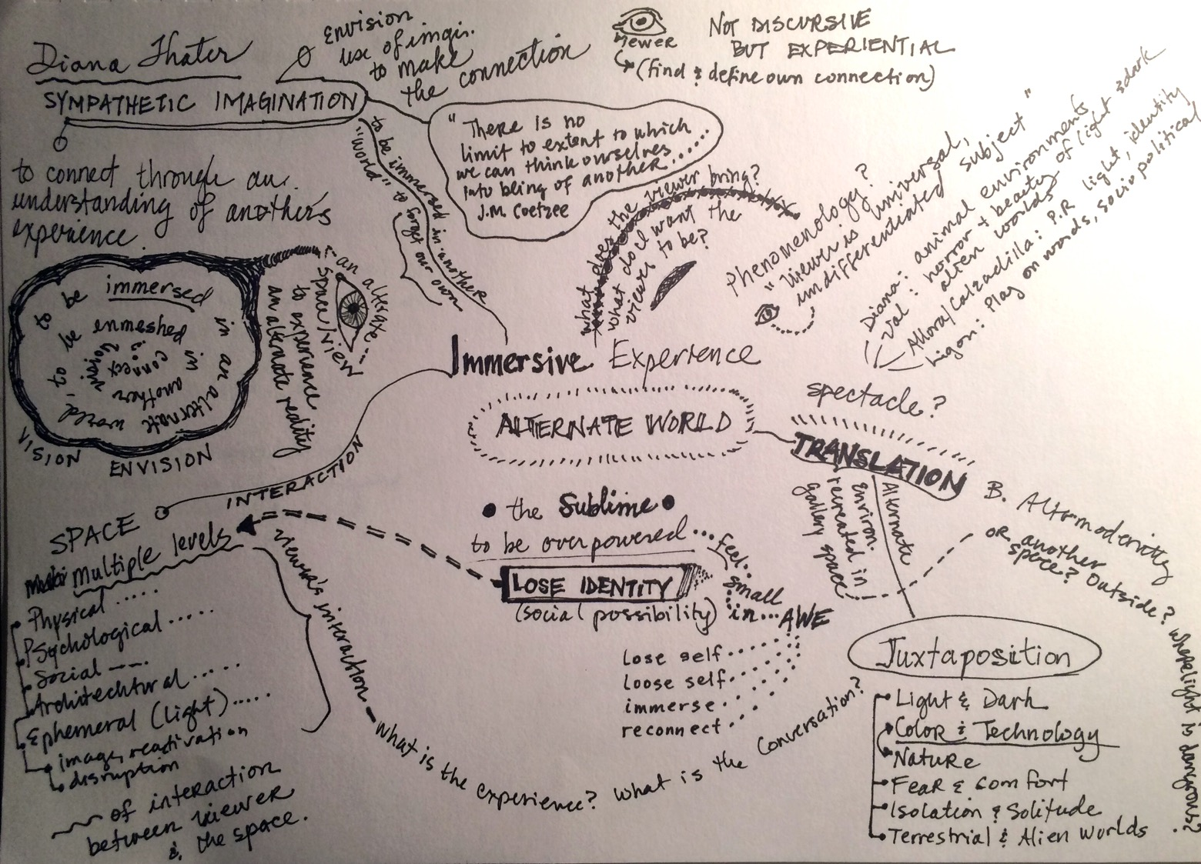
IMMERSIVE EXPERIENCE
DIANA THATER
Notes:
Rescan, add detail slides w fade transitions to follow. Connect to thater w context writing… & more images of her work. Spread out over several slides.

Slide 16
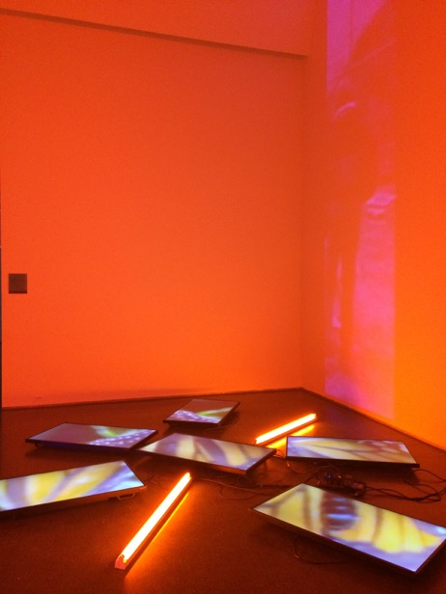
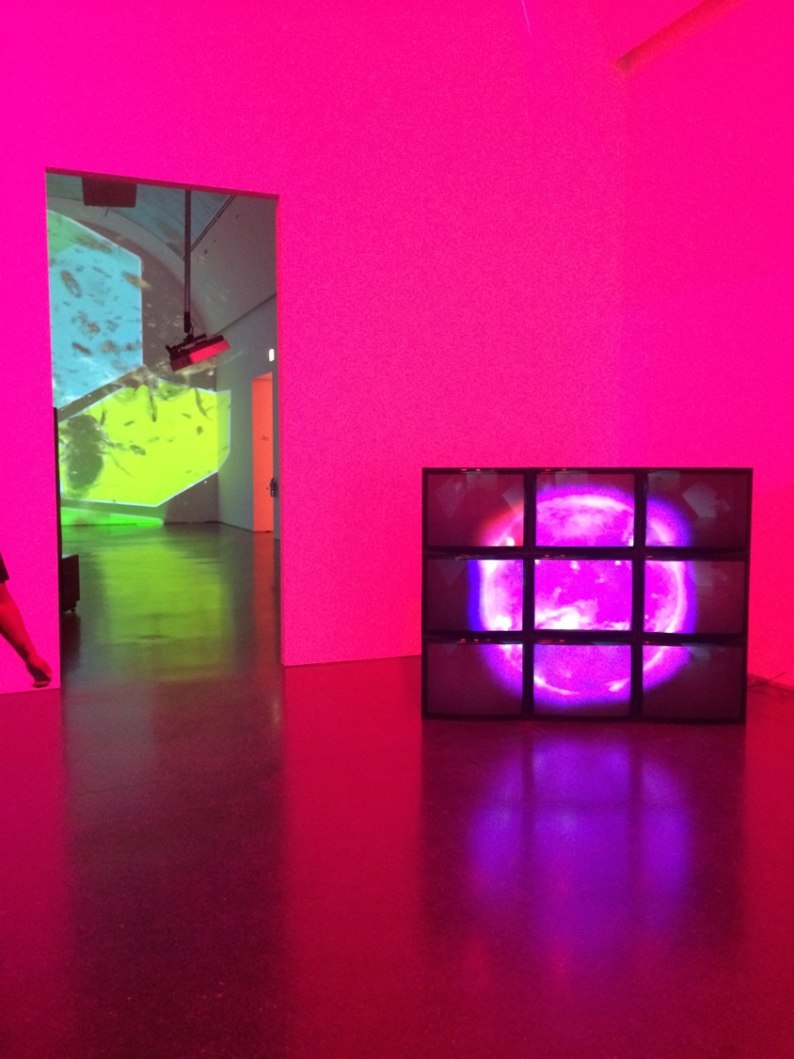
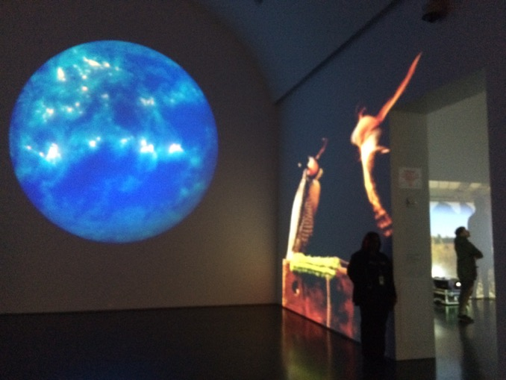
been seen through doorways, therefore interacting with other parts of the exhibit.
Notes:
Insert images of thater that show immersive experience

Slide 17
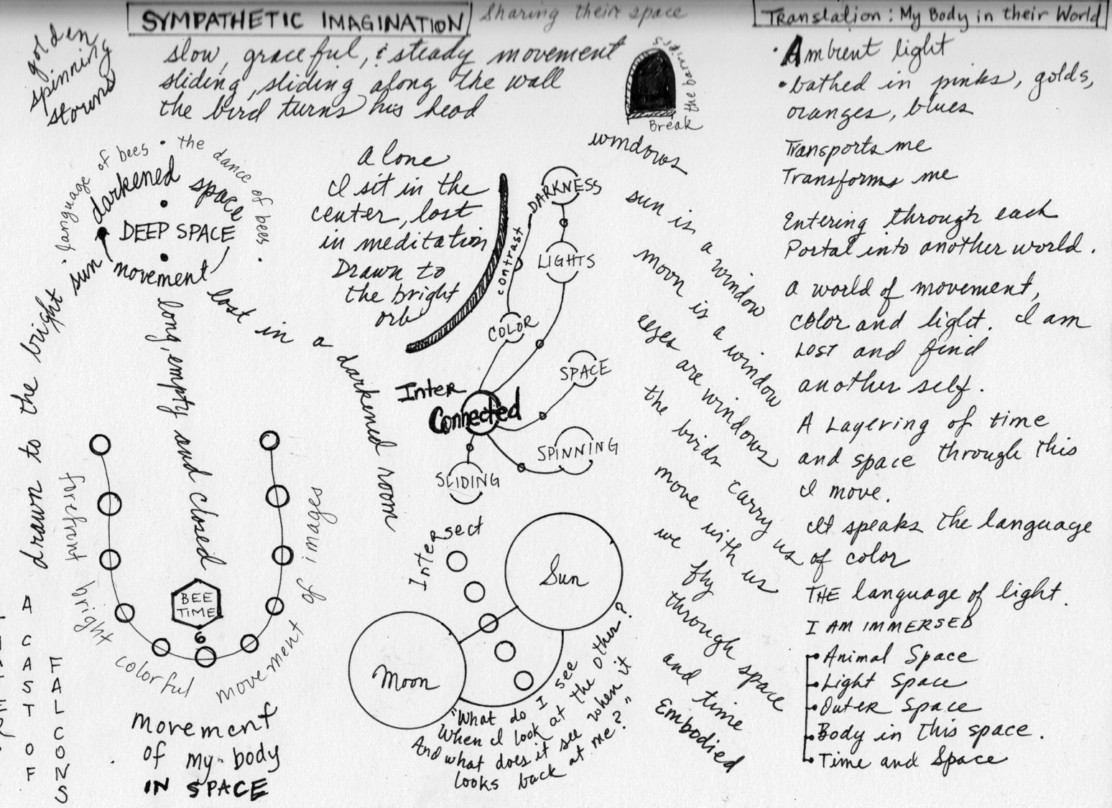
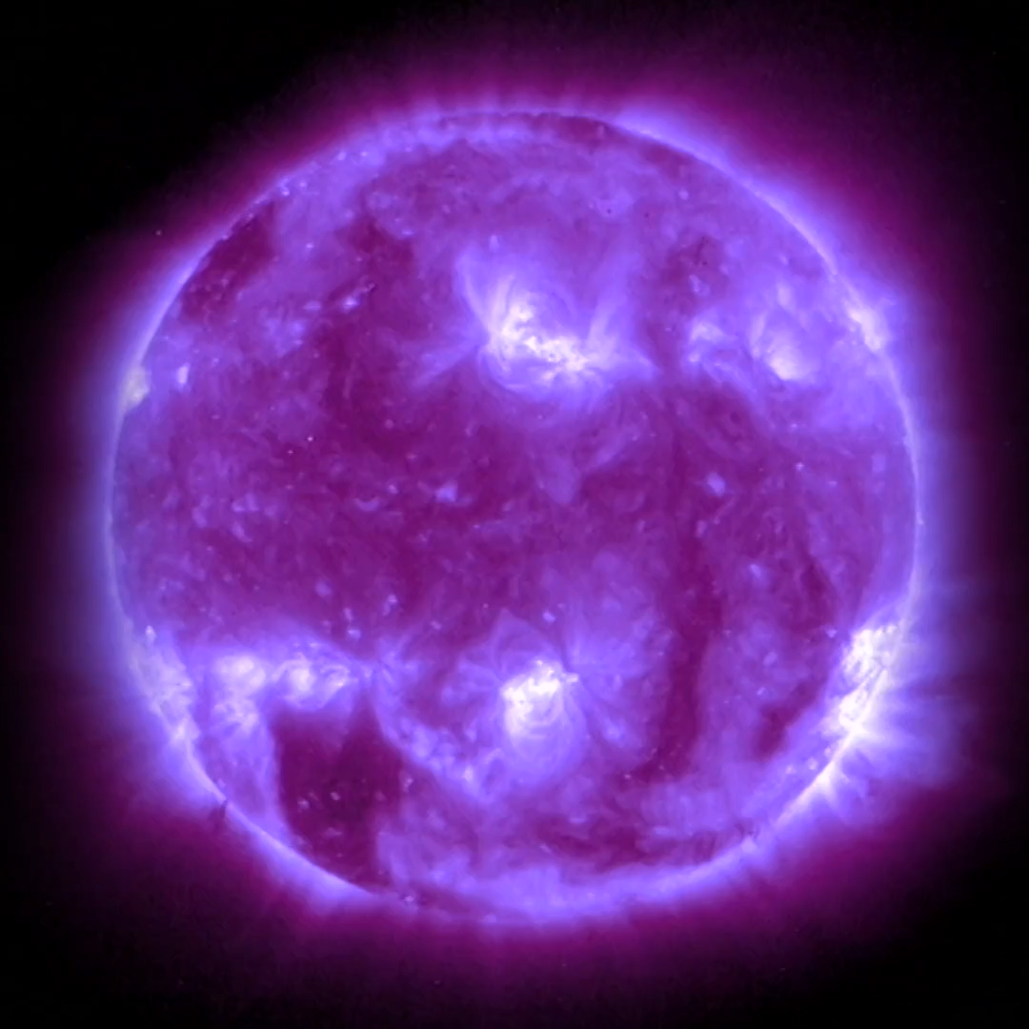
Notes:
Animate video button. Add context writing and detail shots in following slides w fade transition.

Slide 18
that affect the viewers so that they relate on multiple levels. Thater writes about this interaction in the exhibition catalogue.
Notes:
Insert image of delphine and quote thater from catalog.

Slide 19
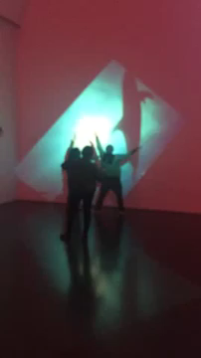
“Co-inhabitants of spaces with real and fictional – or illusory – worlds
The work is a form of memory, a barrage against disappearances” (2)
Immersive = Submersed = Overwhelming = Sublime
Senses
Sensation
Sensual
Perception

Slide 20
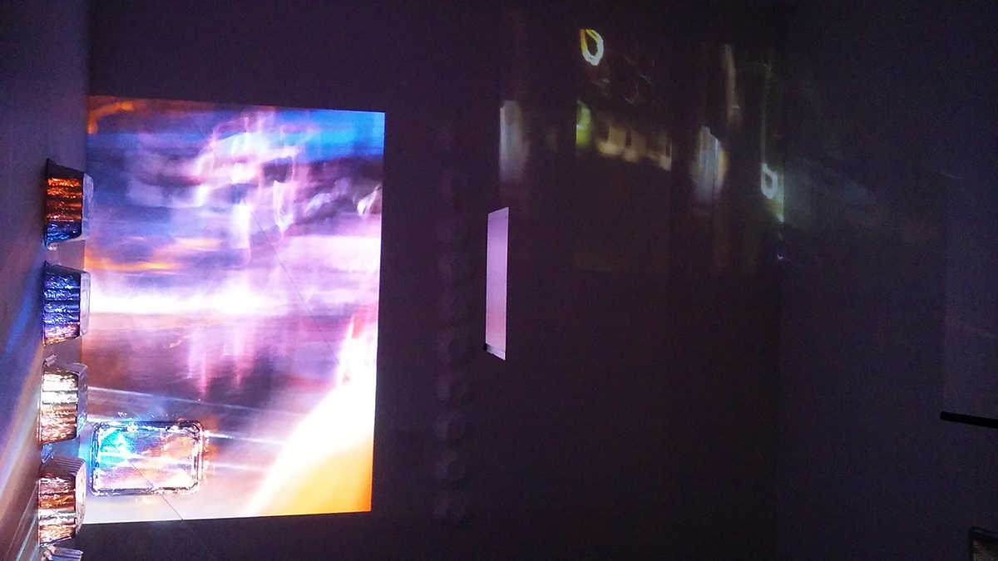
Valerie Xanos, The Sublime Light and Dark; An Experiment in Disrupted Projection, Digital Projections 2016
Notes:
Insert pic of VX projections

Slide 21
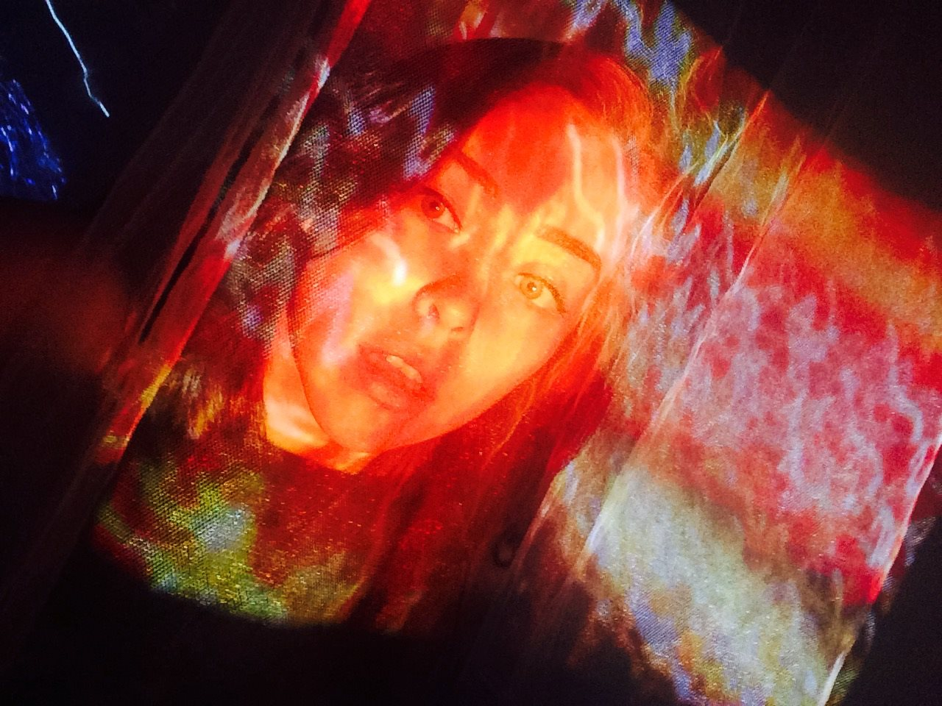
The alternate world of an immersive experience
My work, The Sublime Light and Dark, is art in space that is not discursive in its site or specificity, but rather creates a connection, a nebulous exchange through interactions and submersion into a world experienced through the senses.
An unknown world, beyond the narrative, is translated to a part of us deeper than words can reach.
The Viewer is
Beyond Place & Immersed
Beyond Time & Enmeshed
Beyond Self & Interconnected

Slide 22
Valerie Xanos, viewer immersed in The Sublime Light and Dark; An Experiment in Disrupted Projection, Digital Projections 2016
Notes:
Imsge of athena in projections

